Slide 1
Test
Graphs

Slide 2
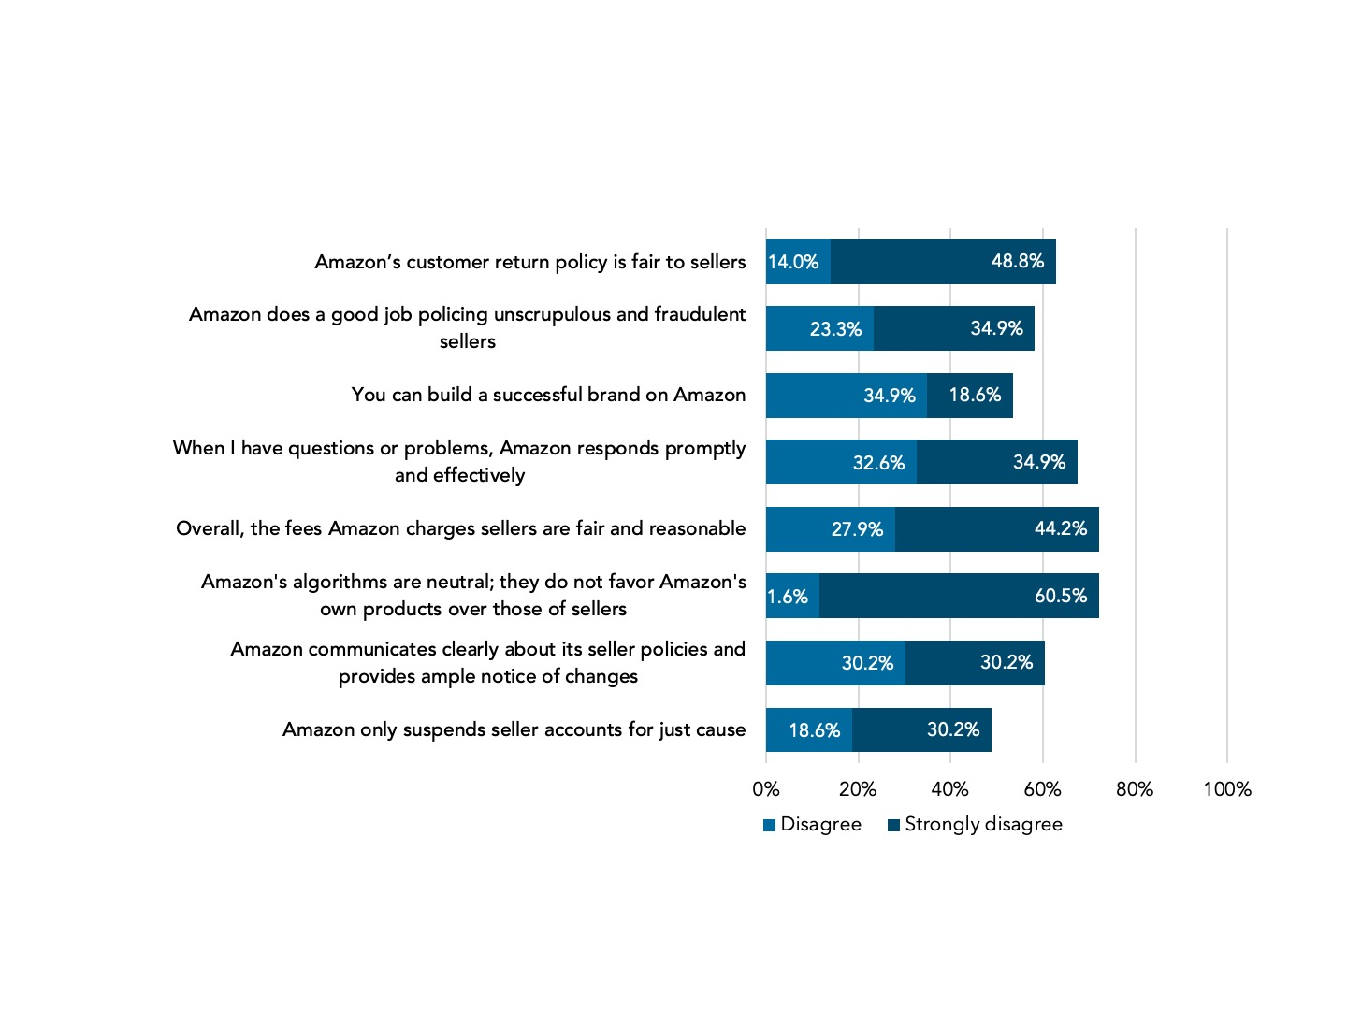

Slide 3
Here we are discussing how small businesses are impacted by corporate power. The top challenges that small businesses face are:
Access to capital
Corporate concentration
Lack of resources

