Slide 1
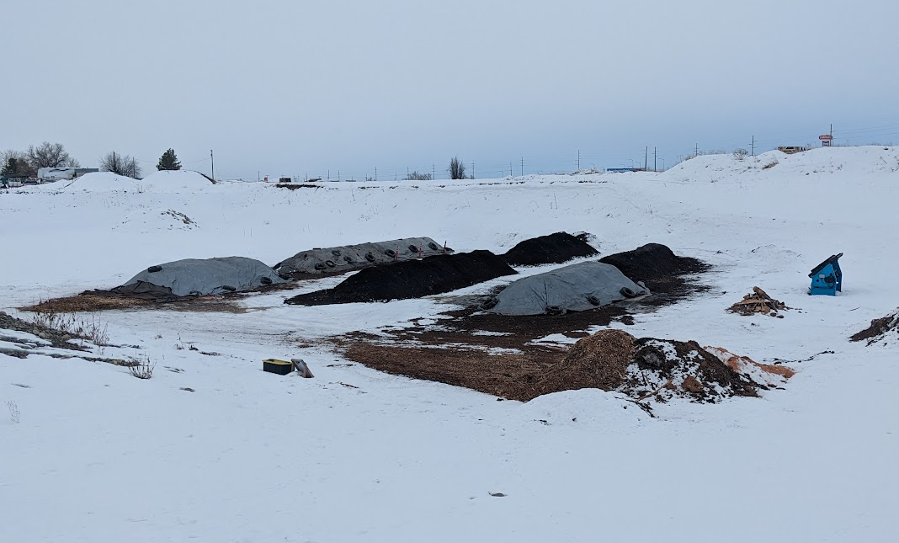
Karl Johnson
Owner / Operator
Belgrade, Montana
Established 2018
8-10 tons foodscraps / week
30 yards compost / month
1 Acre facility
Turned Windrows
Vermicomposting

Slide 2
WARNING: This presentation is just a description of facility expansions / transitions, and a bunch of opinions about lessons learned. Skin your own cat
Using Goals and Limitations to inform facility design and avoid debt
You are what you measure
Process and equipment
Nightmares Come True!!
Utilize Partnerships
Investing time vs. Spending time

Slide 3
Goals:
Create High Quality Products
Provide High Quality Service
Maximize Landfill Diversion
Result:
Bucket Turned Windrows
Vermicomposting
Provide Collection Service
Include Bin Washing
Limitations:
Don’t own Land
No Power at Site
Limited Access to Water
Cold Winter Temps
Semi-dispersed Service Area
Inexperienced Customers
High Labor Costs
But First . . .

Slide 4
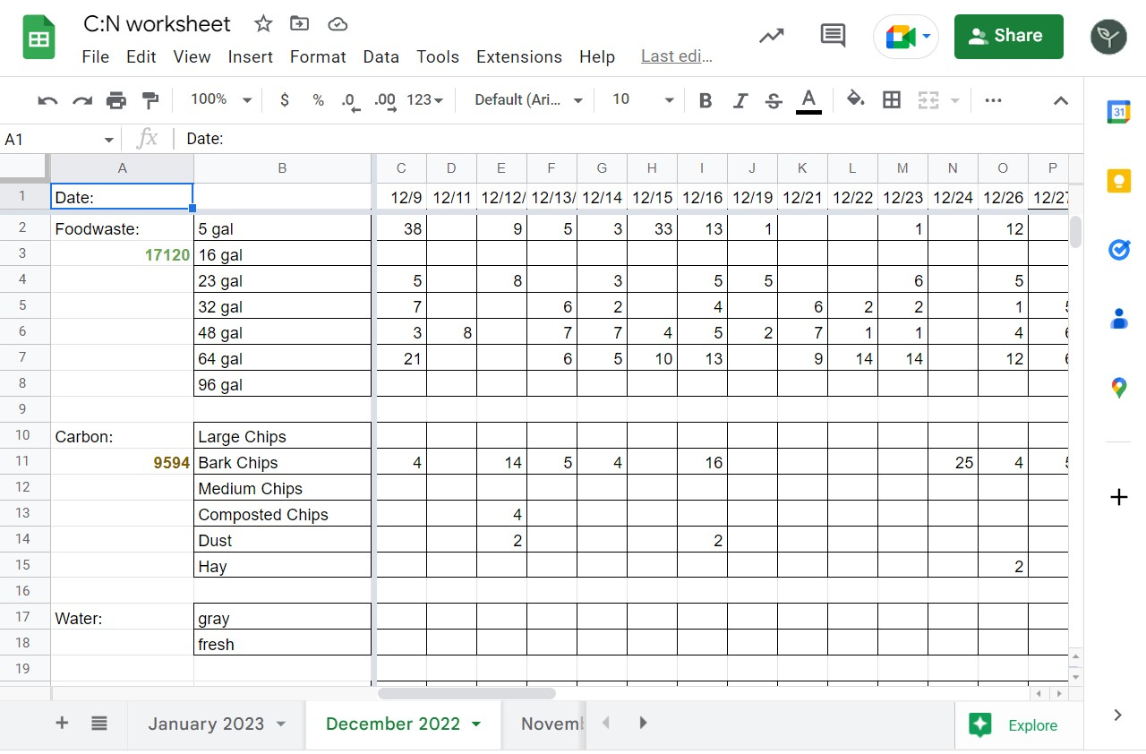
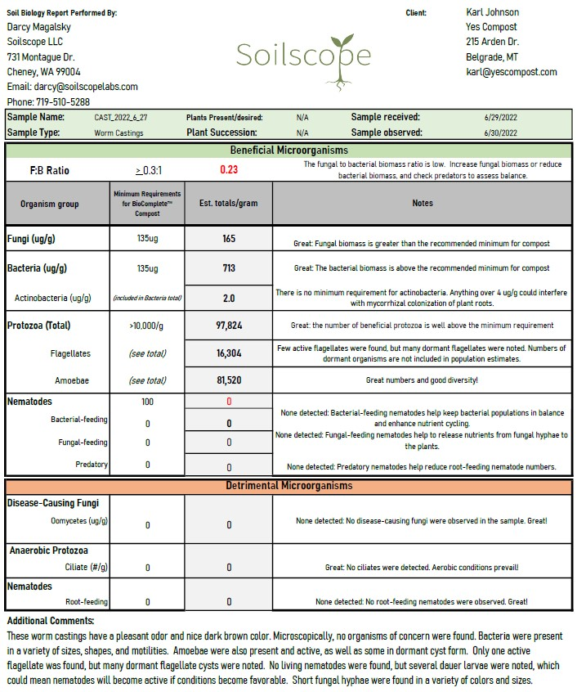
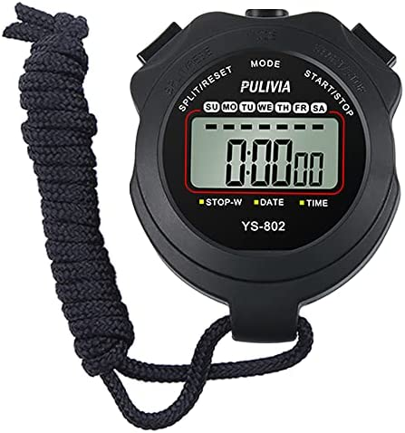
You Are what you Measure:
Inputs / Recipe
Outputs – Biology and Chemistry
Process Consistency
=
Product Consistency
=
Repeat Customers
Accounting Software
Cash Flow Spreadsheets
Time is money – use a stopwatch, literally
As owner, value your own time (or at least track it) - eventually you’ll have to pay someone to do it
Labor cost vs. wage - 1.5 X – insurance, taxes
Price Services in order to afford expansion

Slide 5
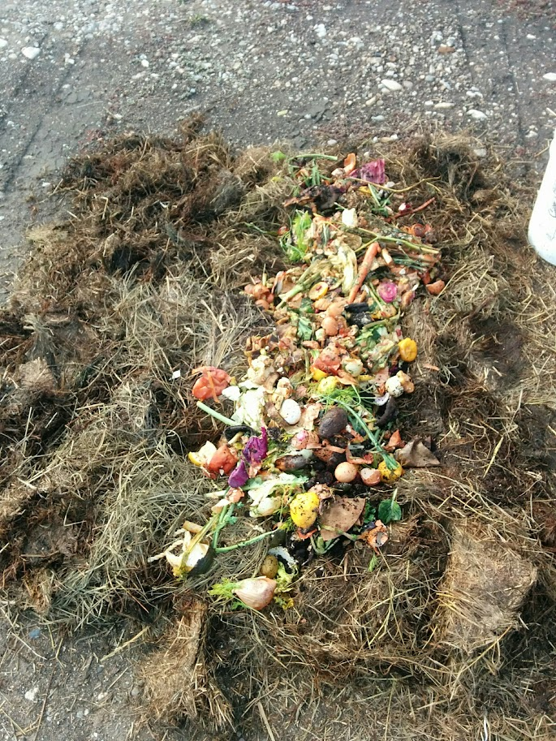
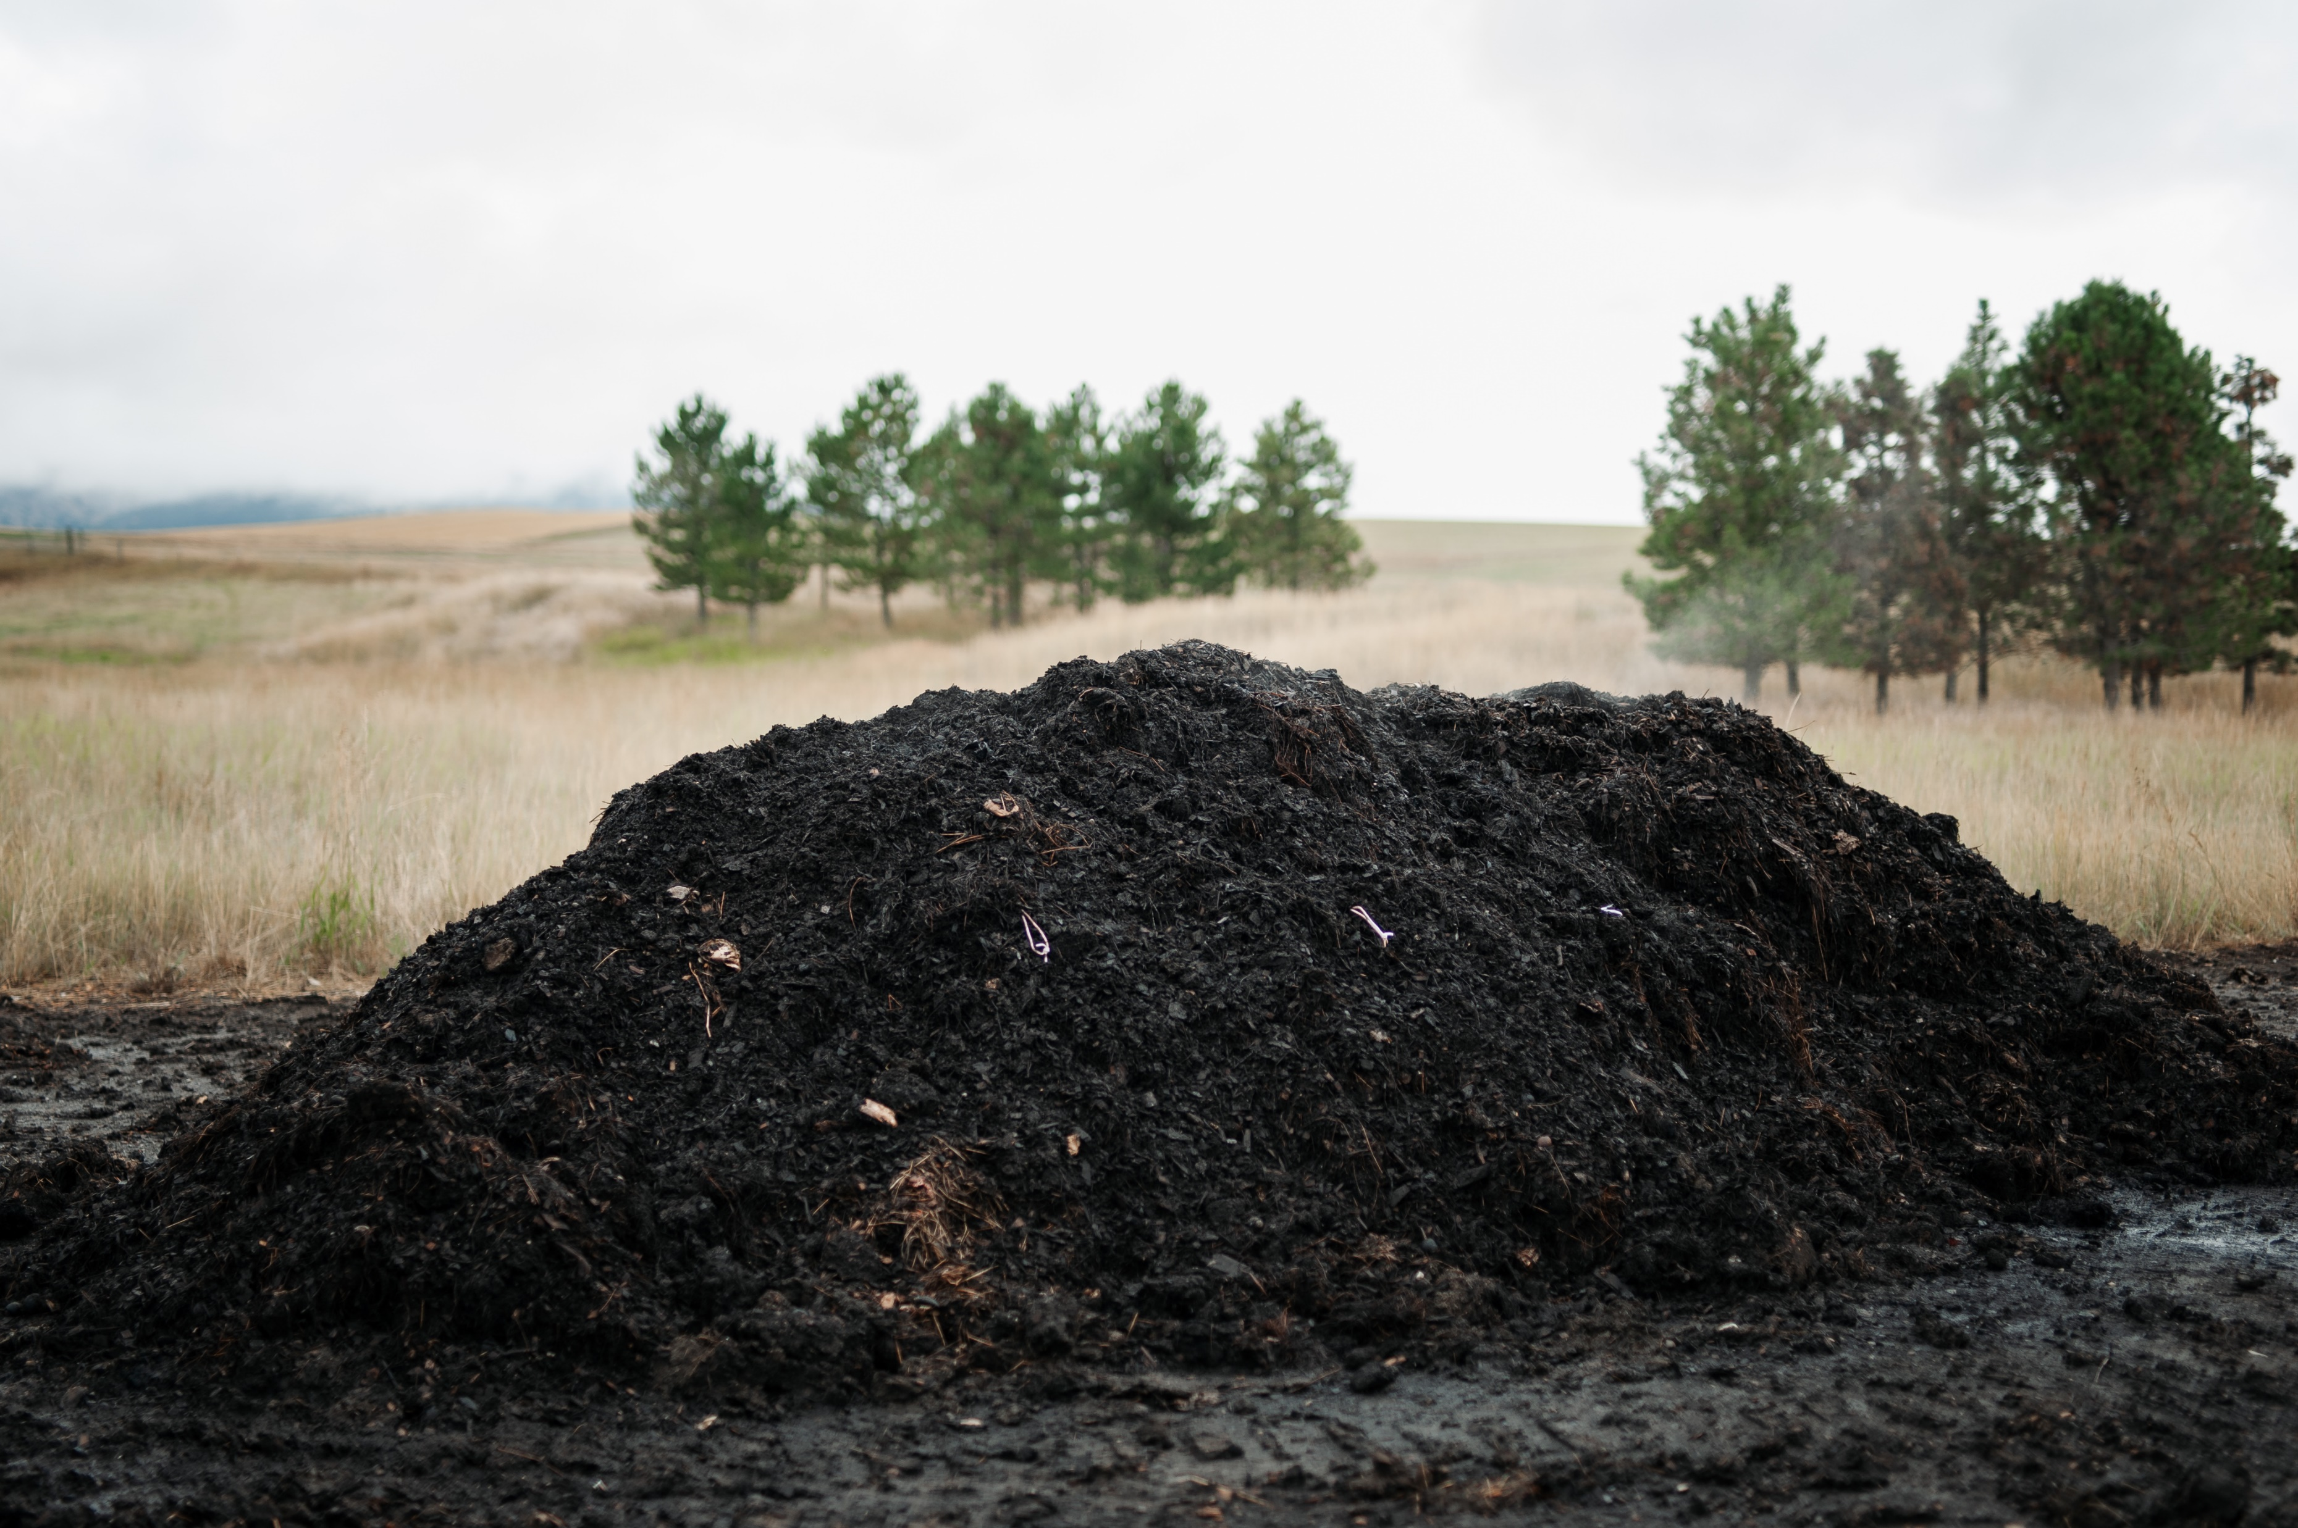
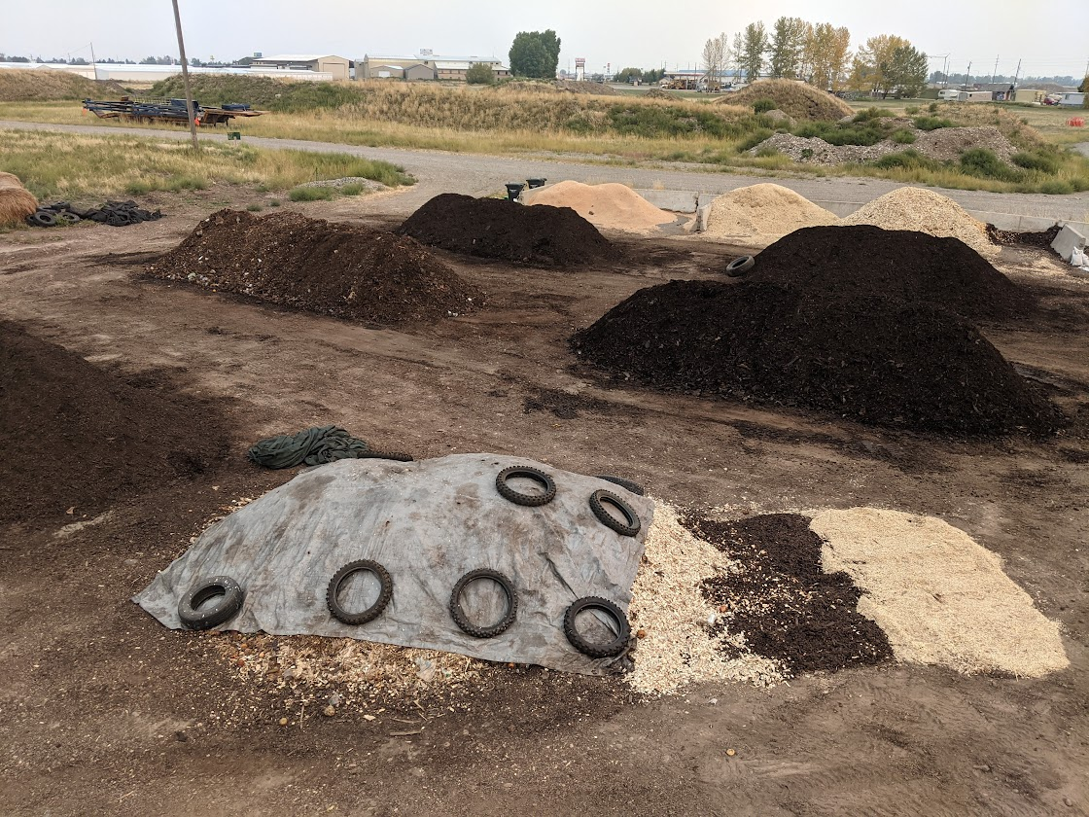
Composting:
Goals:
Maximize diversion
Limitations:
Don’t own Land
No Power at Site
Limited Access to Water
First “windrow”
7 months of material
1 ton / week
8-10 tons / week – active yard

Slide 6
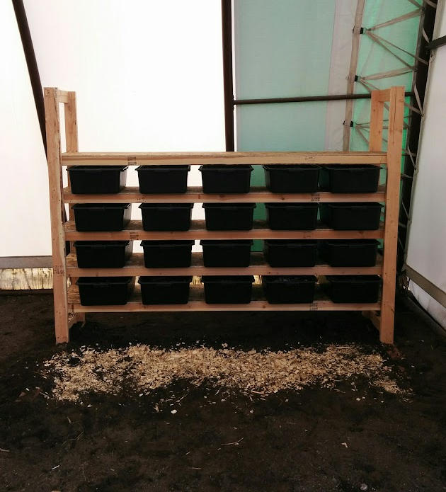
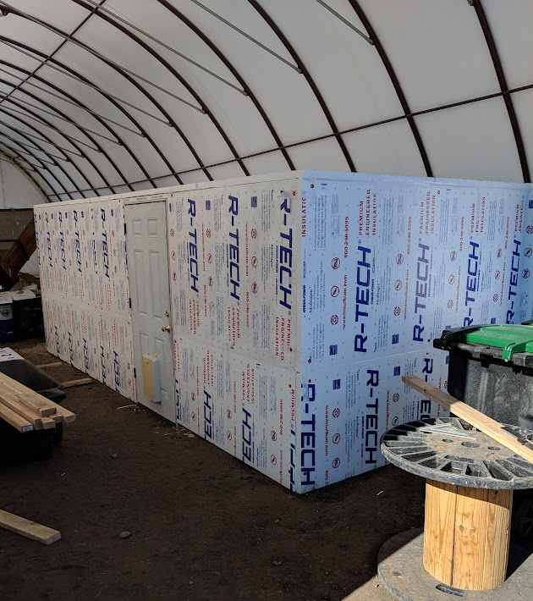
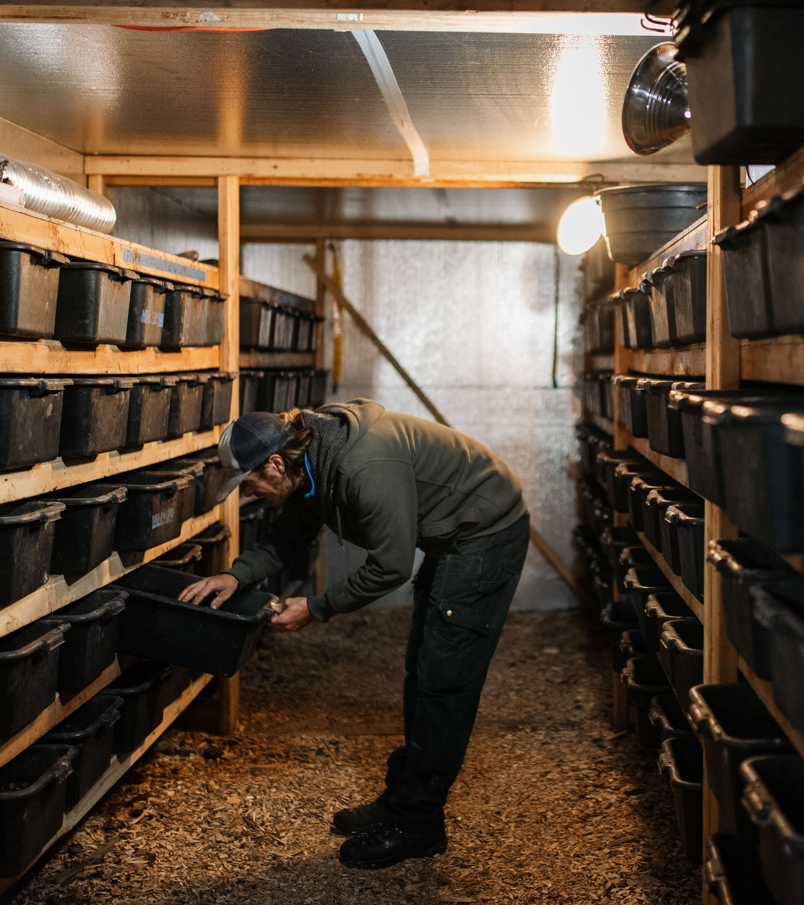
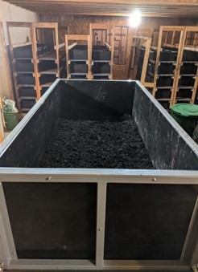
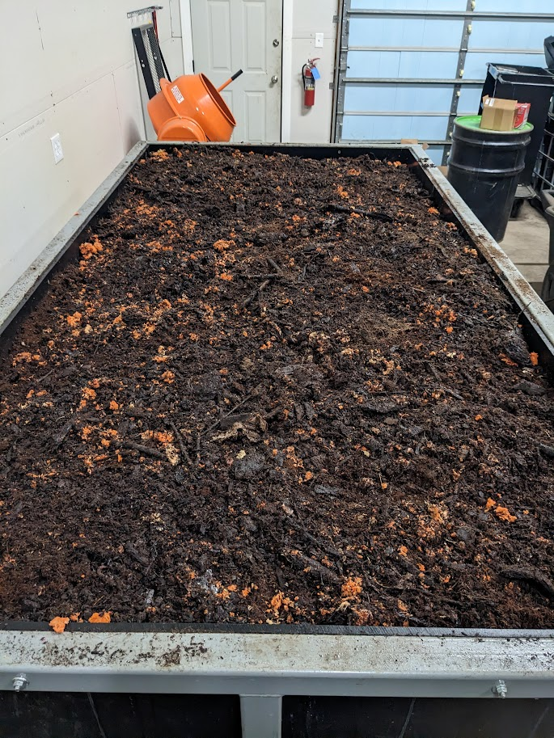
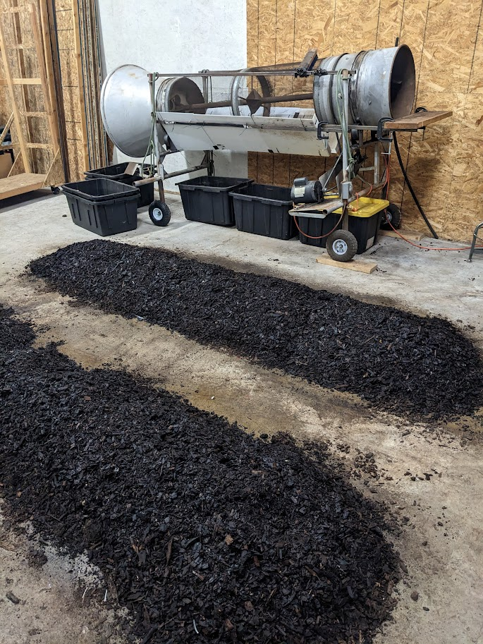
Vermicomposting:
“worm bunker”
Goals:
Create High Quality Products
Limitations:
Cold Winter Temps
High Labor Costs
Winter
Labor + Space
???
Outdoor
Lower cost (rent + labor)
Mimic natural environment
Use Thermophilic heat for winter
“CFT”
Heat and rent $$

Slide 7
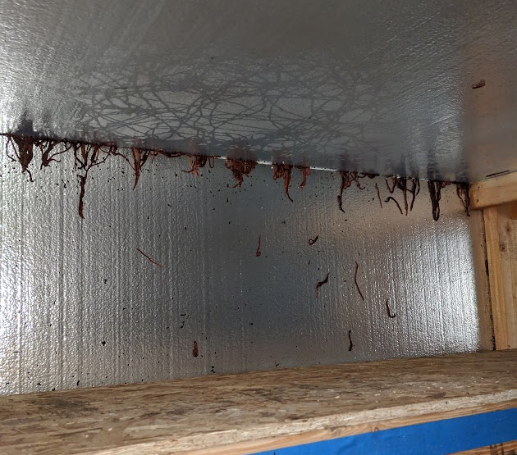
Nightmare scenario!
Learn, then grow

Slide 8
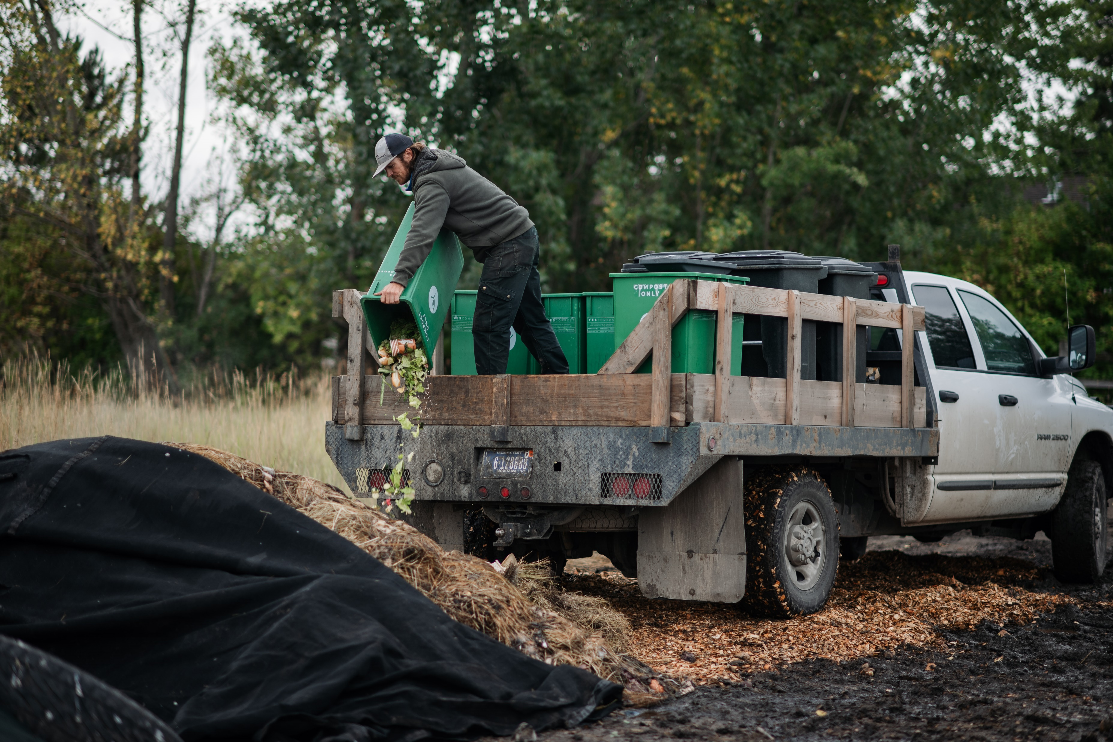
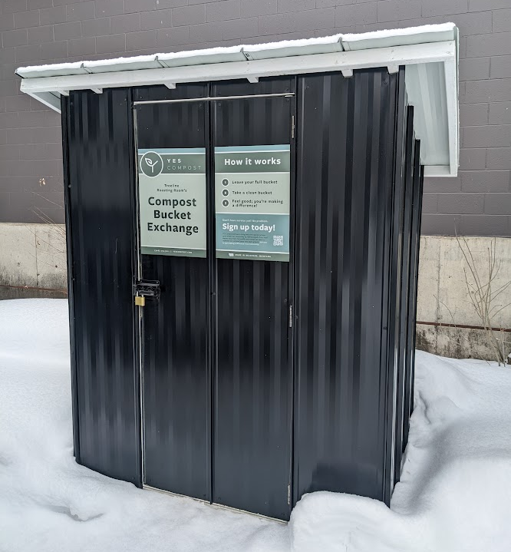
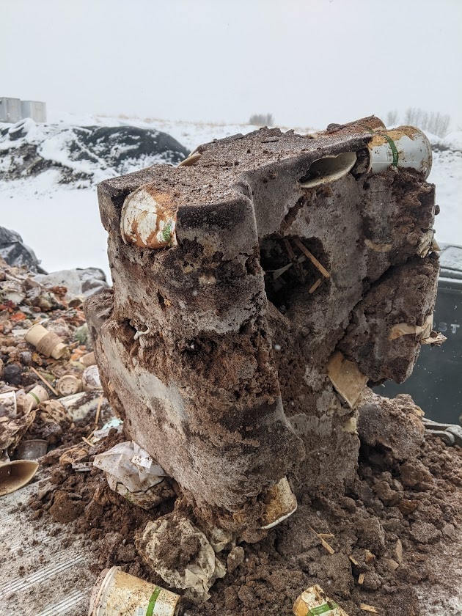
Collection:
Lift Gate!
Goals:
Maximize diversion
Provide High Quality Service
Limitations:
Semi-dispersed Service Area
Cold Winter Temps
Less trips =
Less fuel + labor
“Bucket Exchange” Kiosks

Slide 9
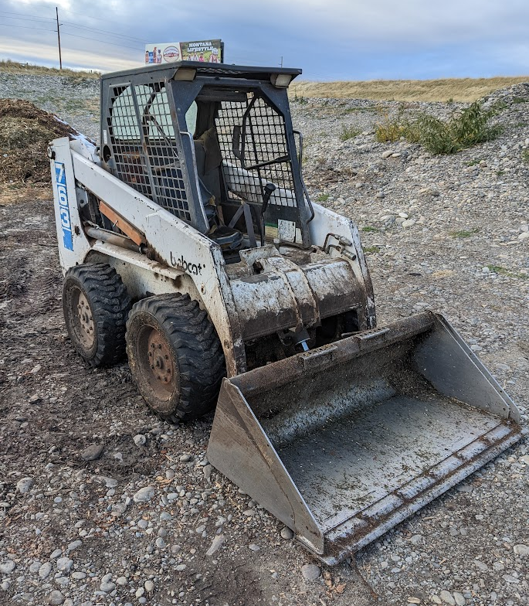
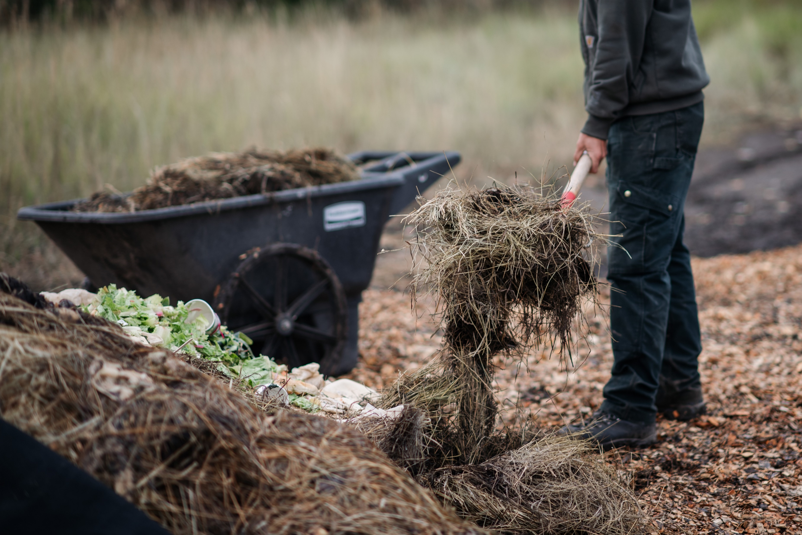
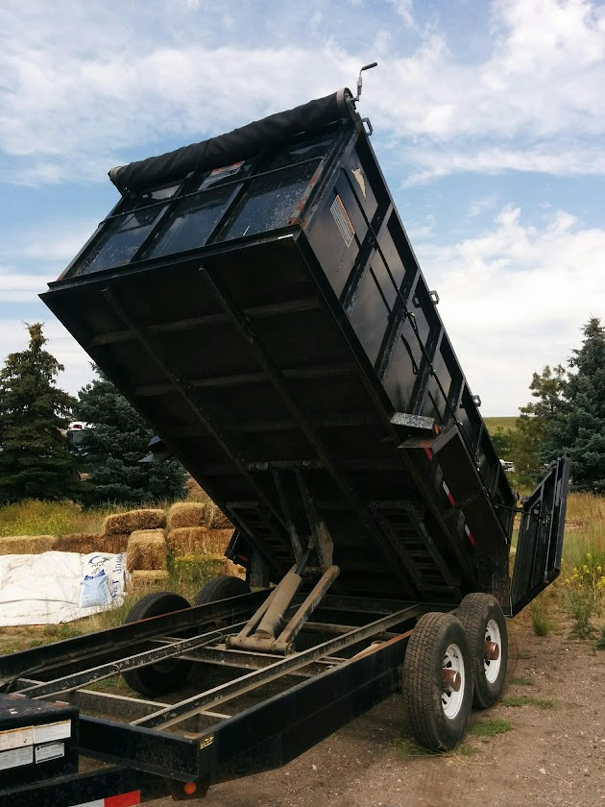
Process and Equipment:
Goals:
Maximize diversion
Limitations:
High Labor Costs
???
Loader?
ASP?
Grants!!
< 200 lbs/week
Buy used, no leaks!
Windrow “flipping”

Slide 10
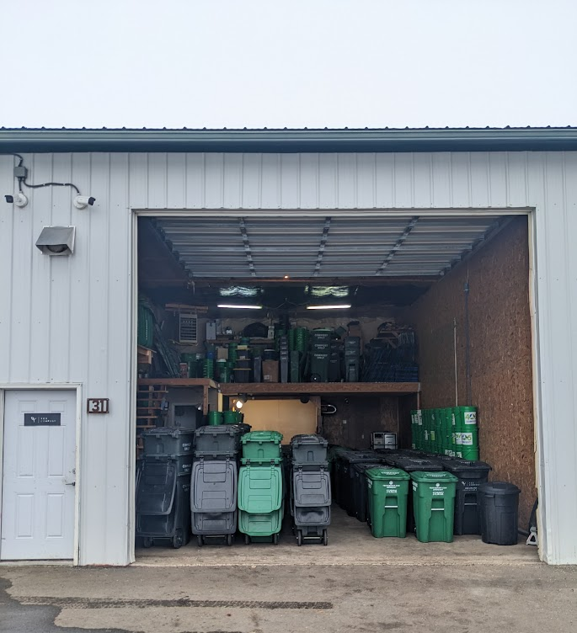
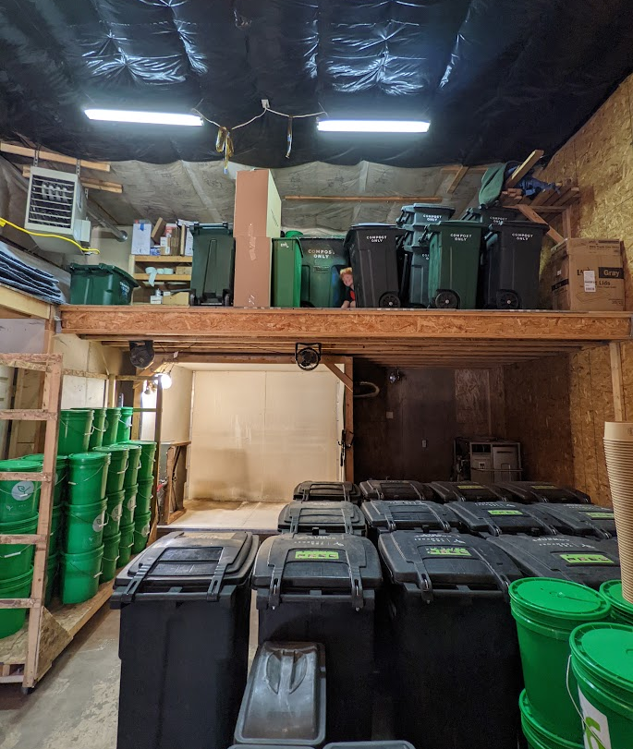
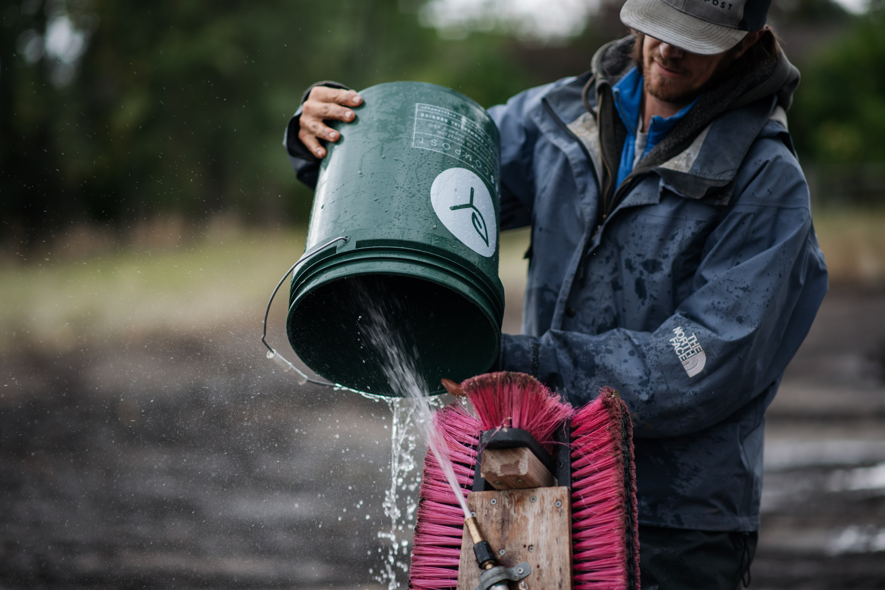
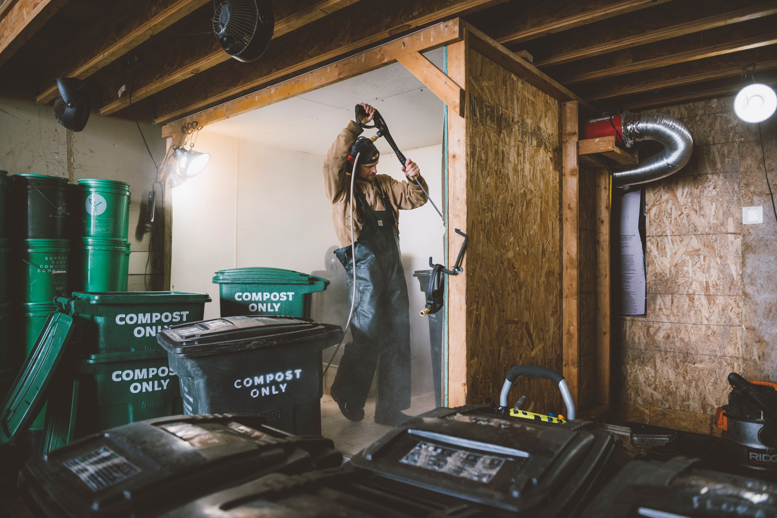
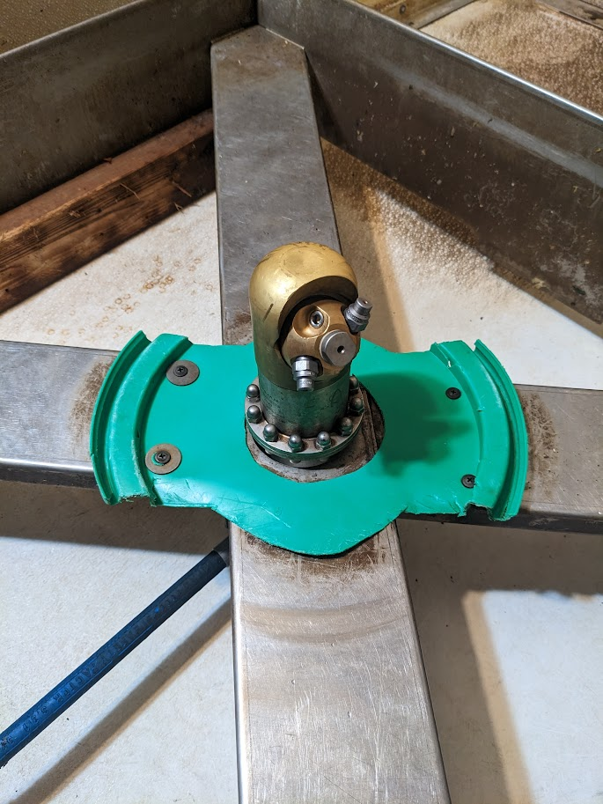
“washhouse” / “wormhouse”
Bin / Bucket Washing:
Goals:
Provide High Quality Service
Limitations:
Limited Access to Water (at compost yard)
Cold Winter Temps
30 buckets / hour
100 buckets / hour

Slide 11
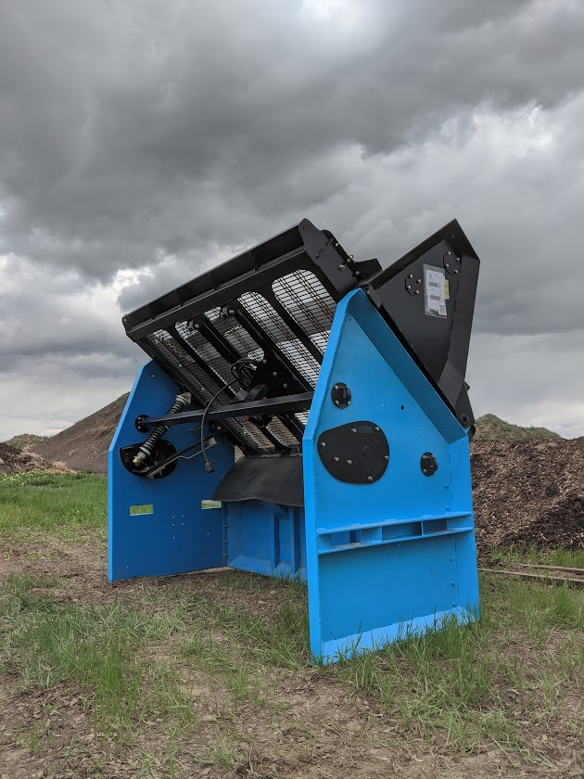
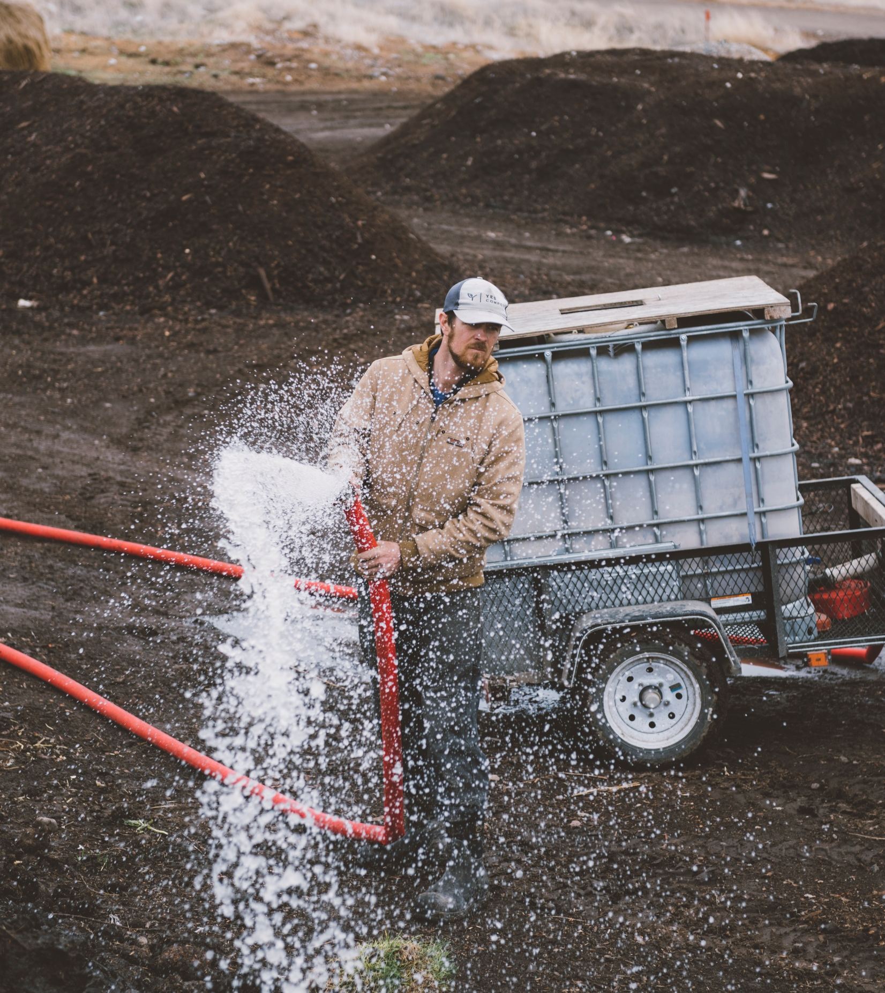
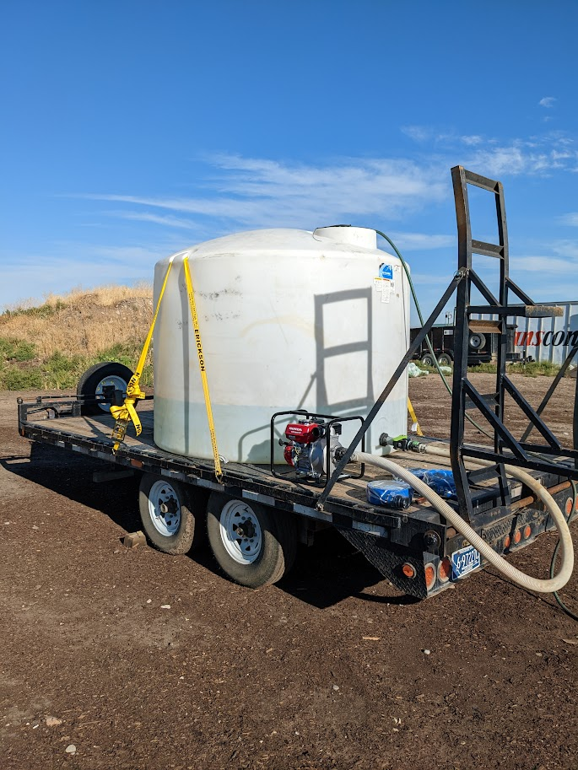
Get Creative!
Goals:
Create High Quality Products
Limitations:
Limited Access to Water
$5000 (new)
$1200 down, balance financed through manufacturer over 12 months
Graywater!!
$500 trailer (new)
Used tank
$200 harbor freight 2” pump
Landlord’s tank and trailer
Fire Safety for property
$500 Honda 2” pump

Slide 12
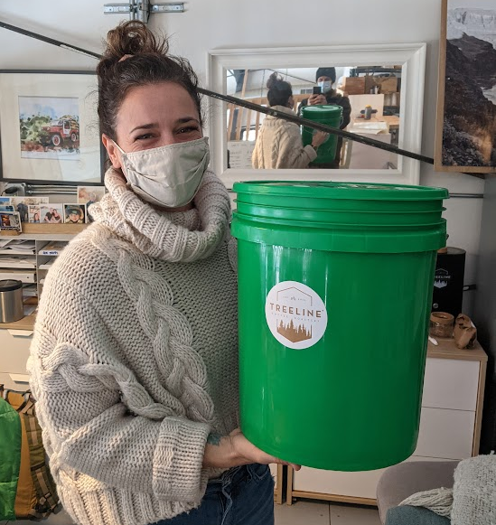
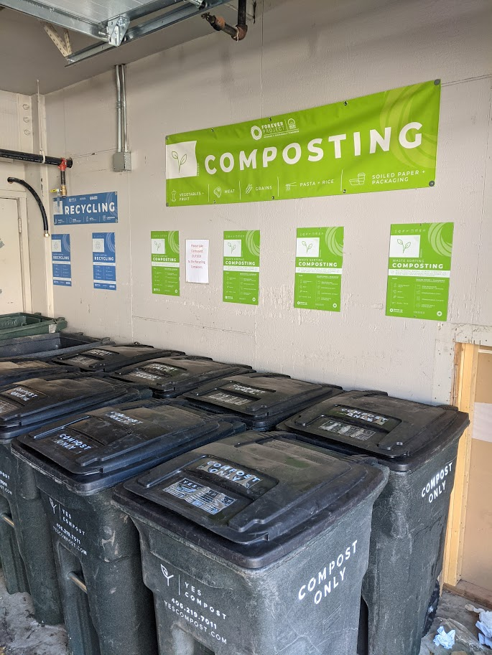
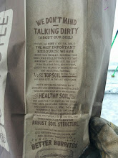
Partnerships – Mutual Benefits
All customers are Partners
Co-branding / advertising
Sustainability initiatives
Municipalities – it’ll happen eventually
Lower cost service
Diversion, lower quality products

Slide 13
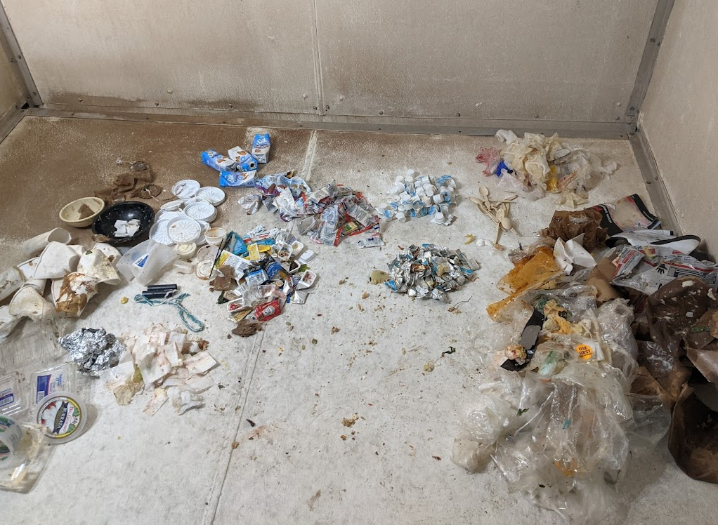
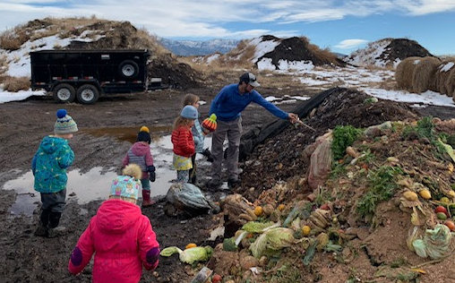
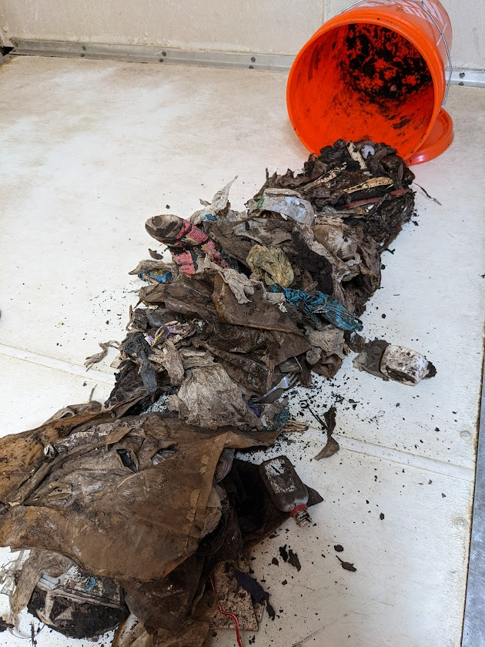
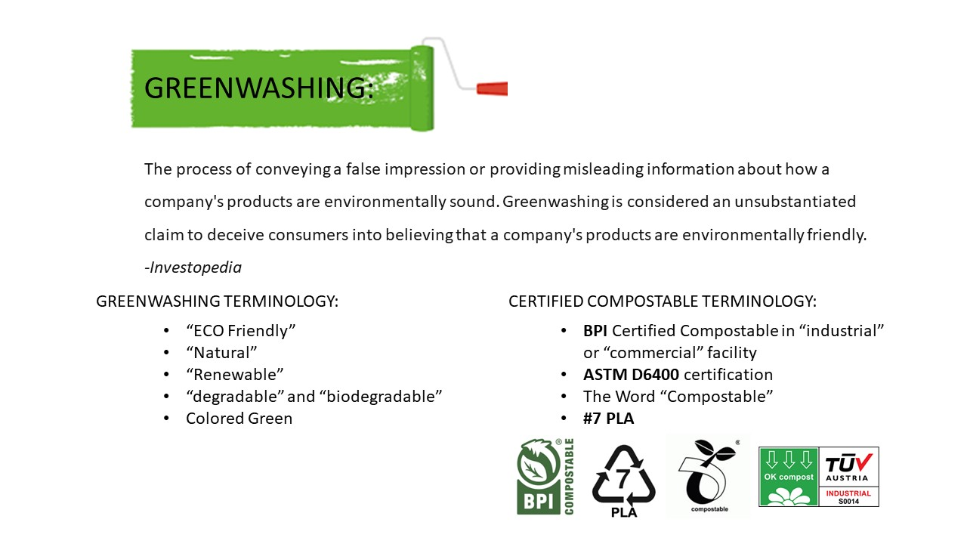
Investing time vs. Spending time –
Decrease Contamination through education
Customer Feedback -
Pictures
Make removal part of the process, don’t just rely on screening

Slide 14
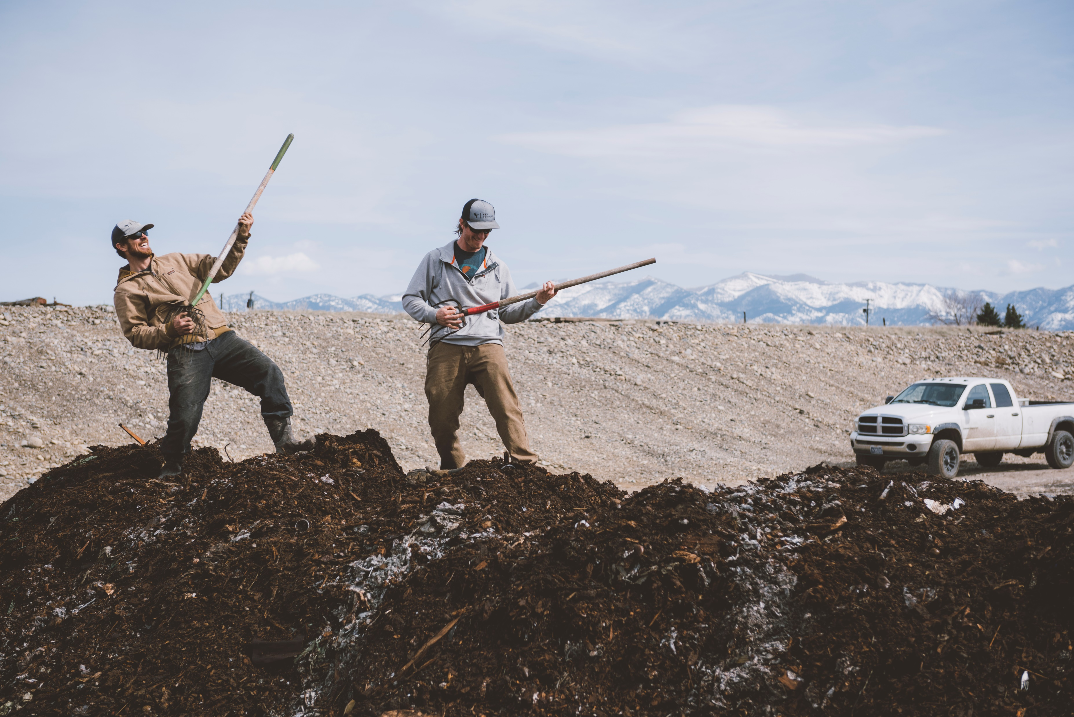
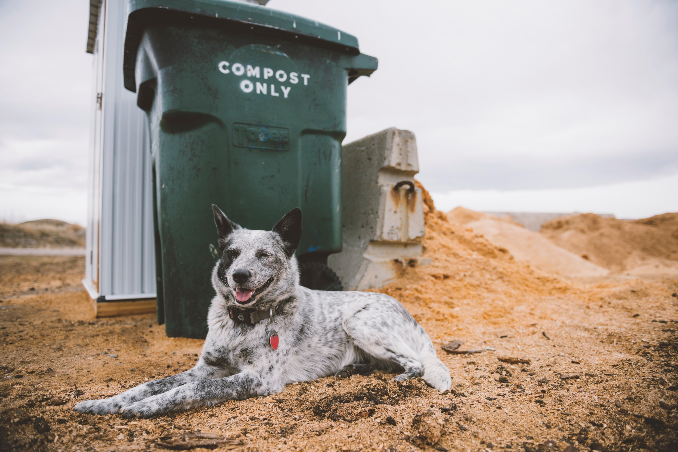
In other words:
Stay curious and be willing to change
Kaizen – continuous evaluation and improvement
Use Data to inform decisions
Know before you grow
Don’t take yourself too seriously, you’re only saving the world, right!!??
Thank you!
Karl Johnson
406-219-7011
@yescompost
Yescompost.com

