Slide 1
Community Composting for Green Spaces “CCGS”
Notes:
- My name is Kourtnii, and I go by she/her/hers. Nice to see many of you again!
- I am currently serving as a Regional Coordinator with the CA Alliance for Community Composting.
- I’m really excited to share what the folks out here in CA have been accomplishing through a state pilot program called “Community Composting for Green Spaces” or CCGS.
- Our journey to rally the team and submit a CCGS grant proposal began literally at the outset of COVID, so it’s been both an ecstatic and challenging 3 years seeing our plan play out in reality. The story ends better than we anticipated, so please sit on the edge of your seats.
- Today, I’ll go over how we built and coordinated our program, sometimes making it up as we went along, and our progress to-date working alongside our community partners to carve out a viable space for community-scale operations in this industry.
- I’ll start with the overall program design and how we selected projects to participate. Then I’ll discuss training project groups and site planning. For most of last year we’ve been focused on data metrics and tracking, so next I’ll discuss what we’ve been looking at and how. Finally, we’re currently in our program assessment phase, so I’ll talk a little bit about our program impact.
- I also want to note that this presentation was first prepared from a collaborative effort by all the CCGS Regional Coordinators for the an industry network presentation one of our teammates gave last Spring. A special thank you to Zro and others for your contributions.

Slide 2
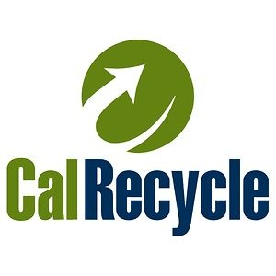
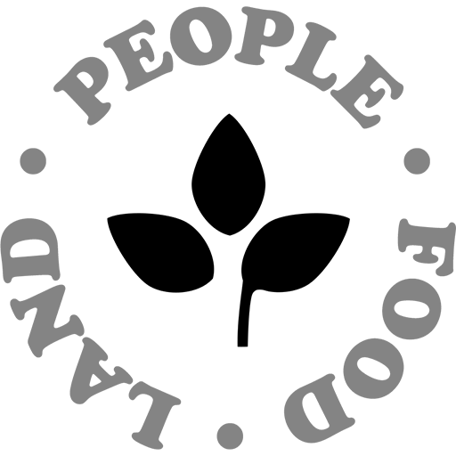
Funded by a $1.5M grant administered by the Department of Resources Recycling and Recovery (CalRecycle) through the California Climate Investments (CCI), and a fiscally-sponsored project of the People, Food, and Land Foundation (PFL).
Notes:
It is important to note that this program is the first-ever funding opportunity of its kind created to help a state meet landfill diversion targets at the community level, and it also works to support goals at the intersection of social and environmental justice. I hope our program strategy can serve as a model that any of you can duplicate, form your own collaboratives, and lobby your local and state government to fund similar opportunities.
None of the individual compost groups in CA were big enough to take on the big bucks and submit an application on their own, so CCGS has been conducted as a partnership under the fiscal sponsorship of the People, Food, and Land Foundation. It also started out as a $1.35 million contract, but we received an additional allocation for excellent performance in June 2021. So in the end here’s the boilerplate language for the full $1.54 million we have received from our sponsors, and for whom we are forever grateful.

Slide 3
Meet the Team
CACC Leadership
Kourtnii Brown, Common Compost
Elinor Crescenzi, Integrative Development Initiative
Lynn Fang, Soil Scientist
Michael Martinez, L.A. Compost
CCGS Regional Co-Coordinators
Kourtnii Brown, Greater Bay Area and Central California
Charlotte Canner, Northern California
Elinor Crescenzi, Inland Empire
Enjoli Ferrari, Greater Los Angeles
Zro, Greater San Diego
Gina Vollono, Greater Los Angeles
CCGS Project Advisors
Louise Bruce, San Jose Conservation Corps
Jessica Chiartas, PhD, UC Davis
Matthew Cotton, Integrated Waste Management Consulting
James McSweeney, Compost Technical Services
Deb Neher, PhD, University of Vermont
Cary Oshins, US Composting Council
Calla Rose Ostrander, The Carbon Project
Brenda Platt, Institute for Local Self Reliance
Cole B. Smith, UCCE Master Composter Program
Notes:
CACC is a non-profit public benefit corporation that was founded in 2017 as a grassroots alliance and formally incorporated during this grant process in May 2021. We are currently made up of about 10 regularly participating organizations who work together to strengthen, protect, and develop small- and medium-scale community composting projects across the state, empowering composters alongside the communities they serve.
The CACC leadership team designed the core components of the CCGS program with support from our project advisors, and worked collaboratively to prepare the winning application to CalRecycle for implementing the program.
The CCGS regional coordinators are working with 105 groups throughout the state in vastly different types of communities to steward local community composting work: from urban cities to rural areas and on Tribal Lands.
We have organized our team’s program engagement into 6 regions:
Sacramento & Northern California
The Bay Area
Fresno & Central California
The Inland Empire
The Greater Los Angeles area, and
The Greater San Diego area

Slide 4
Understand barriers to starting and managing locally based composting programs.
Provide resources for new and existing programs.
Identify success factors.
Provide models for effective and sustainable community composting operations.
CCGS Project Goals
Notes:
CalRecycle’s goal with CCGS is to support basic market development for community-based and small-scale composting projects, and to ensure long term sustainability for such operations so that communities can continue to offer place-based jobs and make healthy soil.
Ultimately, this program will help California, and other states that wish to model this type of investment, better quantify the capacity that community-based infrastructure and programs could have for meeting landfill diversion targets.
It is also meant to help CalRecycle better identify the most effective and affordable models to scale for community composting operations

Slide 5
Prioritize accessibility to historically underserved communities
Demonstrate value of decentralized, local composting networks
Provide holistic analysis of program impacts and metrics
Increase community resilience to climate change and food security
CACC Commitments
Notes:
However, we all know that diversion targets are just one part of the picture here.
CACC is also committed to providing CalRecycle with a more holistic understanding of the “return on investment” we get from community composting.
We’ve designed our programs to specifically address equity and inclusion by prioritizing the selection of projects from historically underserved groups, low-income groups, groups in the start-up stages of their business development, and especially minority groups, such as:
Black and Indigenous People of Color
Migrants
Refugees
LGBTQIA+ and trans/non-binary folks
Folks with disabilities
And folks who are incarcerated or formerly incarcerated
We’ve been reporting the amount of food grown and distributed to food insecure folks at each site, number of trees and other urban greening work, the amount of community education events and workshops that have been hosted at sites, and total volunteer hours spent on projects in addition to paid labor.
Moving in this way, we can co-create an inclusive future where impacts are measured by more than just dollar-per-ton metrics.

Slide 6
147 Applications
35% from low-income and DAC
6% from DAC only
28% from low-income only
26% were not located in either a DAC or low-income community, but serve them
5% from non-priority applicants
Notes:
So, we ran two application rounds from October through December of 2020. We published our outreach materials in English, Spanish, and Simplified and Traditional Chinese online, and through social media, flyers, in-person, and in-print.
CCGS regional coordinators contacted over 500 community leaders and organizers working in fields related to composting
This resulted in 147 applications submitted to participate in CCGS, 3 times more than CACC originally proposed to fund.
And 95% of the applications received were either located in or directly benefit underserved, low income, and social/environmental justice communities in all six regions targeted for support.

Slide 7
Selection Criteria
LOCATION (15pts)
RESOURCES (15pts)
COMMITMENT (15pts)
Project Location
Land Access
Organization Location
Funding
In-kind Donations
Volunteers
Past Accomplishments
Future Goals
Systems Change Work
ORGANIZATIONAL CULTURE (15 pts)
ADDITIONAL CONSIDERATIONS (40 pts)
Community Empowerment
Trust Building
Collaboration
Interviews
Site Visits
References
Impact and Equity
Decision Making Structure
Eligibility
Diversity
Efficiency
Scalability
Feasibility
Notes:
CCGS core leadership created comprehensive selection criteria on which they were able to score each applicant on a variety of variables
And then rank according to priority need
Due to the applicant density in Southern California, CACC was able to select all applicants in those 3 regions, and in Northern California, where the same project efficiencies could not be replicated, they conducted a competitive selection process.
Ultimately, CACC was able to accept 95% of applicants for an inaugural cohort of 132 project sites working with 100 community groups.
For the 5% of applicants who were not accepted into the program, most either did not serve priority populations or were deemed ineligible because the sites did not provide “new landfill diversion capacity” in their municipality.

Slide 8
Soil Stewardship Training Retreat
16 CURRICULUM TOPICS:
Soil Health
Decomposition Ecology
Compost Ecology
Compost Processing
Vermicompost
Community Engagement
Value-Based Communication & Community Well Being
Ecological Garden Design
Compost Site Design
Bioplastics
Compost End Uses
Compost Quality
Waste Stream Sorting
Resource Recovery
Soil Policy
June 20-25, 2021
Ontario, CA
Notes:
https://youtube.com/playlist?list=PLY6OF4oXCBS87V3HVDn_PrNH_hCJ6CKIc
In June of 2021, after all program participants were selected and approved by CalRecycle, CACC hosted a week long NO COST Soil Stewardship training series–which became more affectionately known as Soil Summer Camp
85 participants attended in person and camped out at Amy’s Farm in Ontario, CA and 25 other participants joined virtually
Working alongside the CCGS expert advisory group, Lynn Fang and CACC core leadership developed a comprehensive 16 module curricula
These training sessions were recorded and remain available to watch for FREE on YouTube, and the supporting materials can be downloaded from our website.

Slide 9
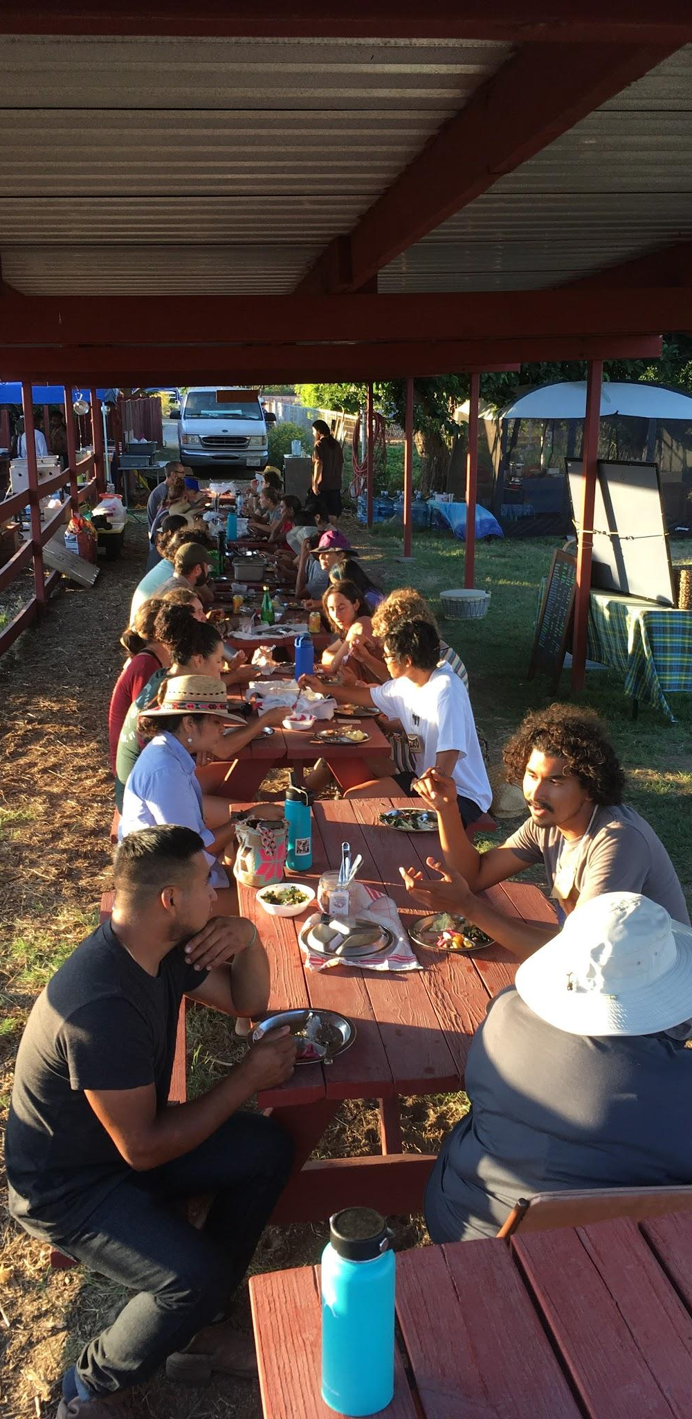
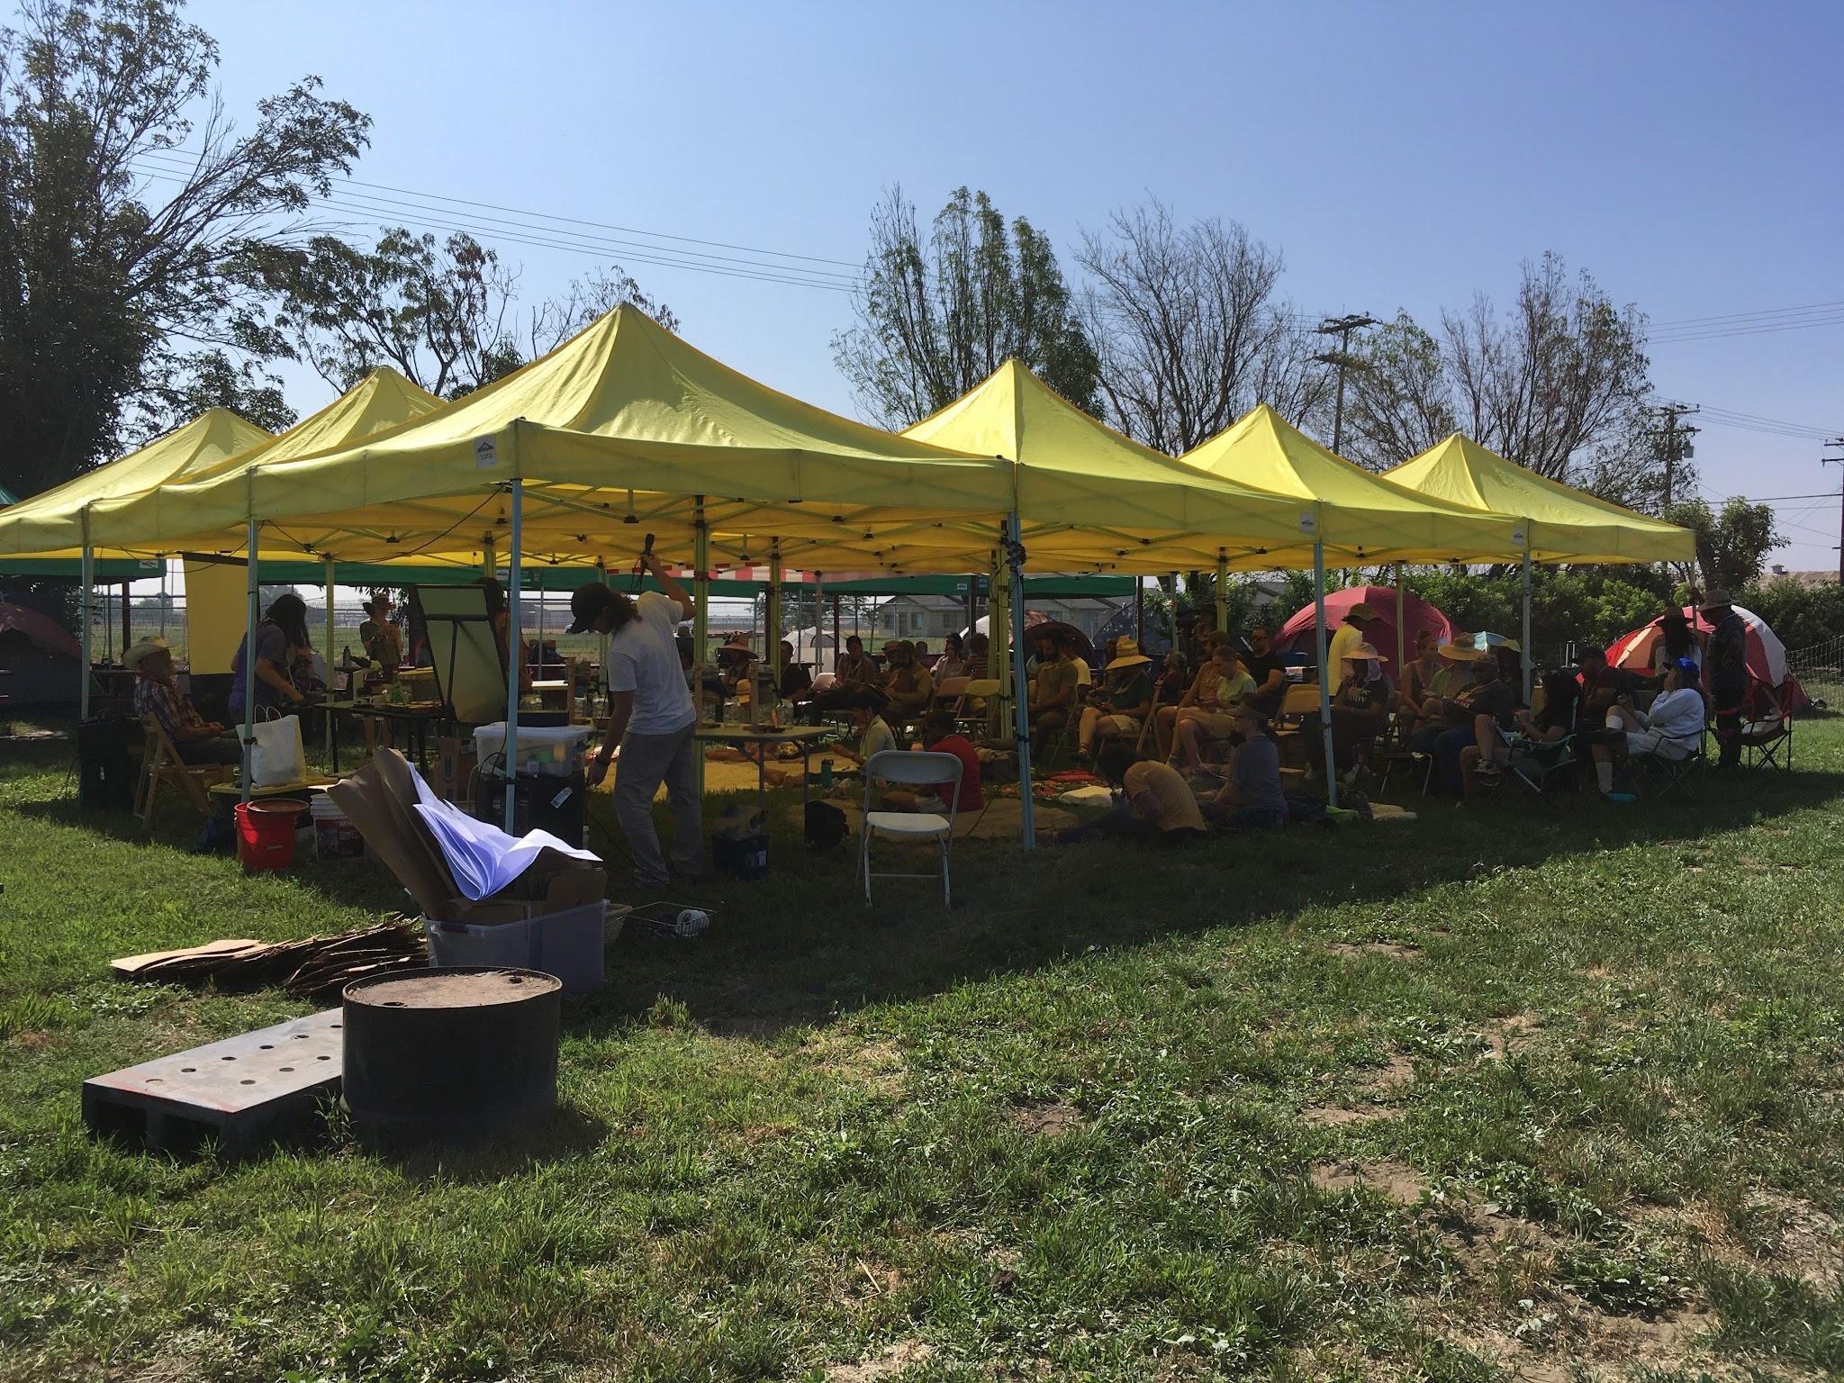
Notes:
During Soil Summer Camp, CACC diversified the learning landscape between 3 days of lectures, 2 days of site visits, hands-on activities, and countless shared learning dialogues about our successes, failures and experiences.
As part of our commitment to equity and accessibility– the Food Cycle Collective prepared and served ethically and organically sourced meals–and CACC honored the sacrifices people made to be at the training by offering stipends of $100/day to all in-person attendees.
CACC empowered site operators with resources to get trained and showed people that their participation and contributions in trainings are invaluable in catalyzing this work

Slide 10
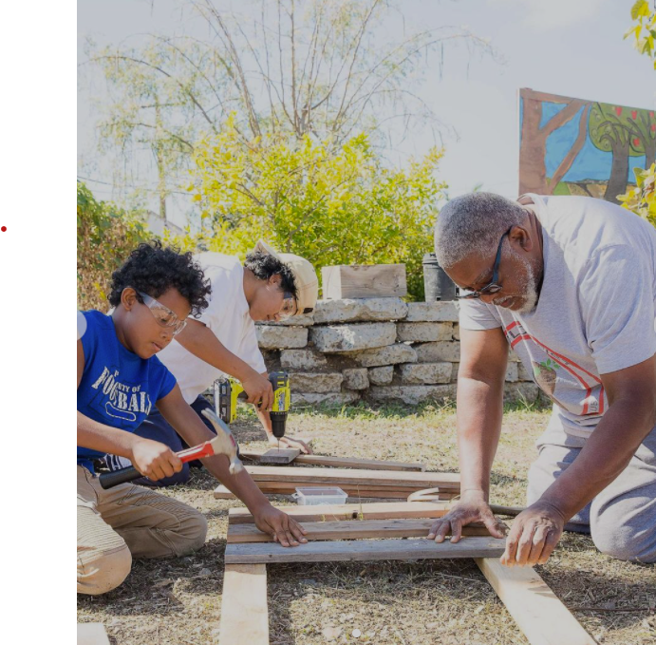
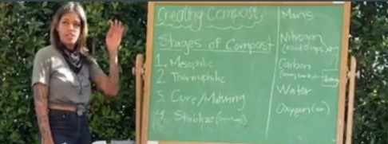
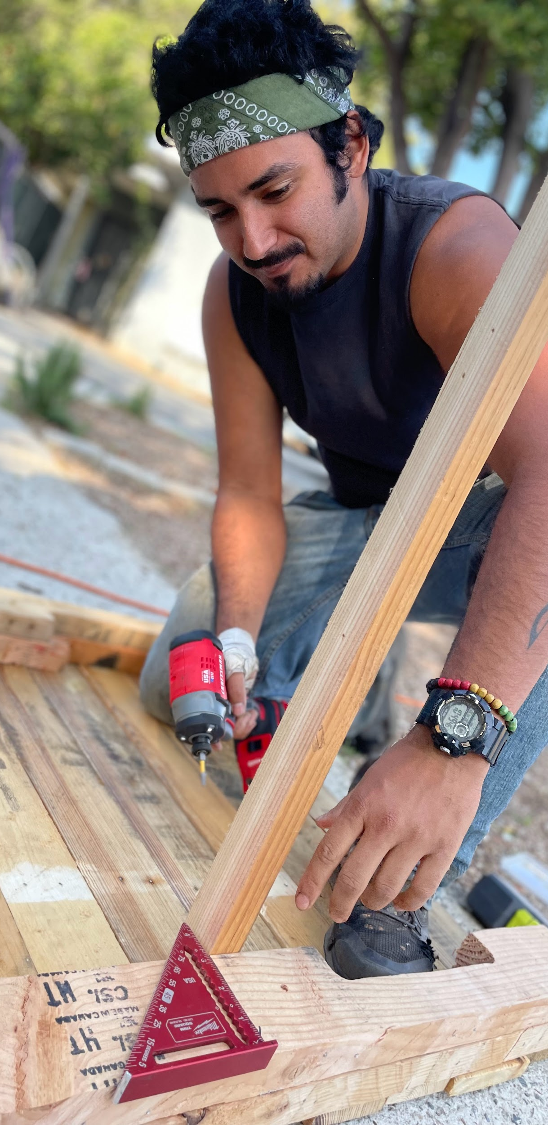
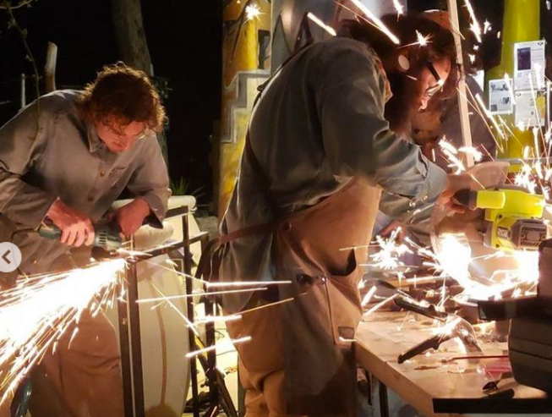
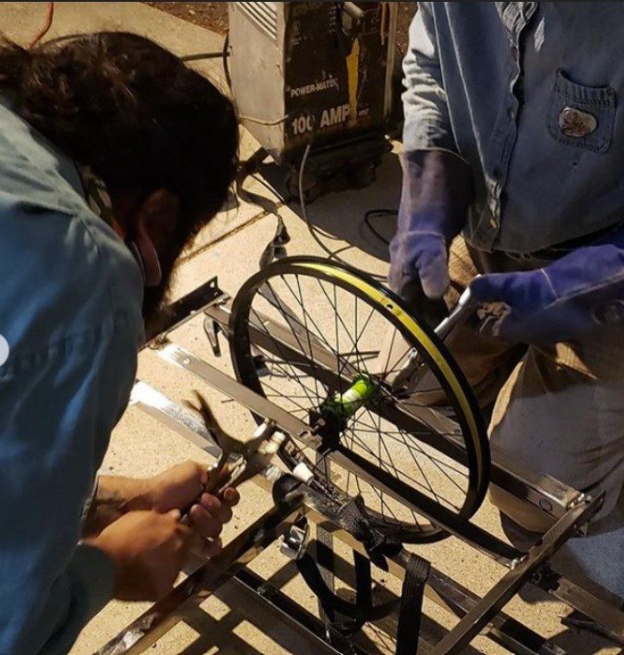
Notes:
By the end of Soil Summer Camp, 98% of attendees claimed they were more confident to operate composting programs where they live, and many expressed they were interested in hosting their own workshops.
Beyond this, people had formed real bonds and cross-regional connections with one another, which–after the full year of isolation and virtual living we had all endured–has made California’s network of community composters even stronger!
CCGS Regional Coordinators continue to conduct additional trainings for sites that request assistance in strengthening their technical skills and community engagement, and some CCGS groups are also now training each other directly.

Slide 11
Site Preparation and Launch
Site visits
Site plans and budget proposals
Identifying community partnerships
Infrastructure development
Policy guidance
Notes:
The next step for us was to support each project in developing and focusing their visions to be able to craft site plans and budget proposals, and allocate resources for each region based on those needs.
For months, we worked intimately with each team in participatory dialogue
Visiting their sites
Talking through ideas and possible obstacles
Identifying community partnerships and
Guiding folks on local compost policy

Slide 12
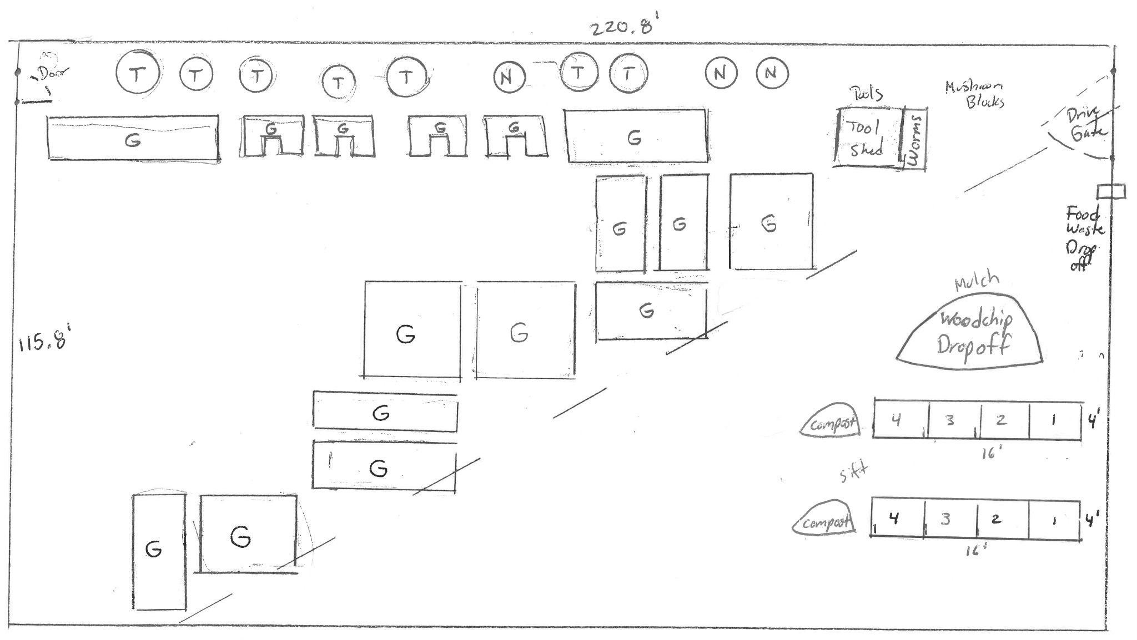
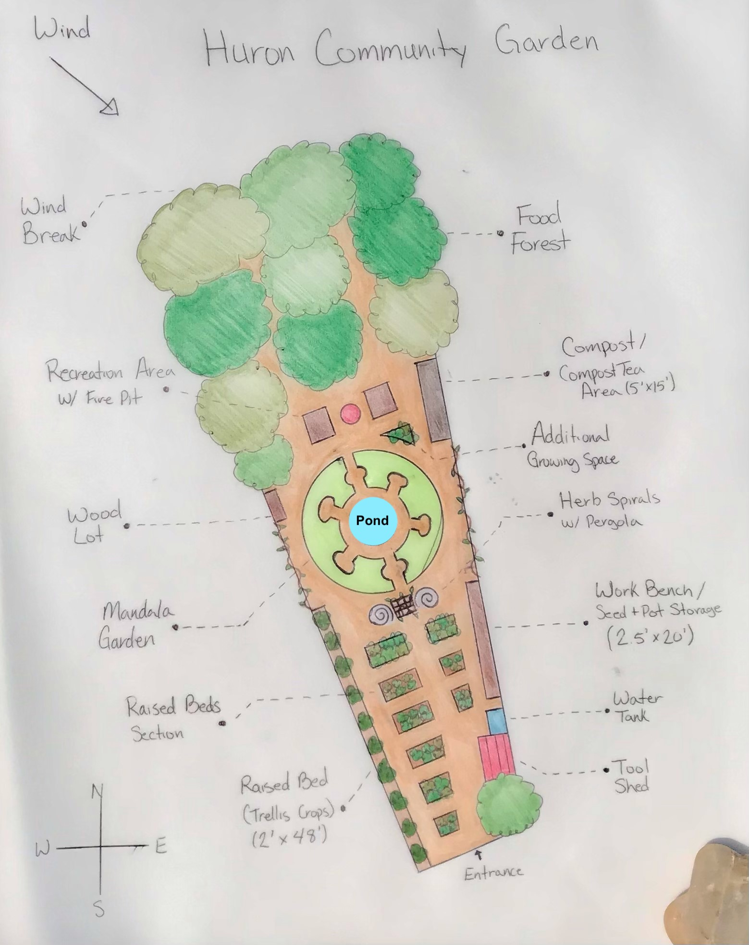
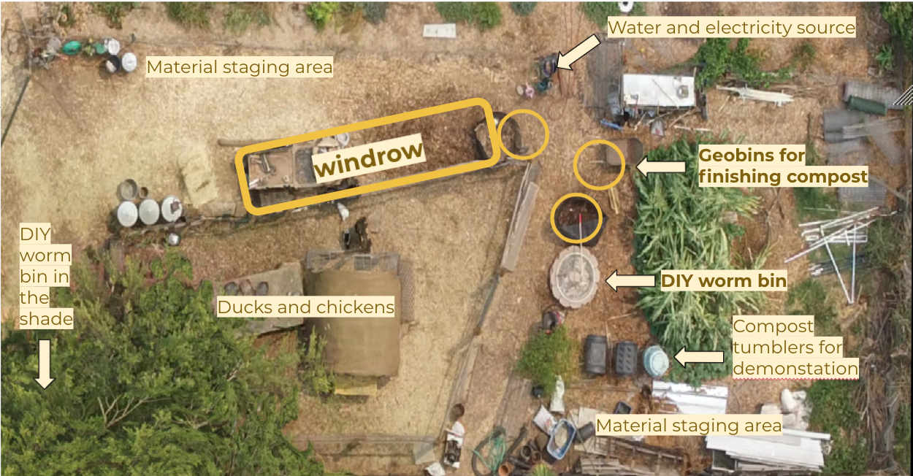
Notes:
In some cases, this required thoughtful, ecological design to create spaces that were reflective of deep community feedback. In other cases, we worked with groups to maximize compact spaces by using mixed methodologies, like aerated static piles in combination with vermicomposting, in order to process more material on limited lot sizes.
These are some examples of site designs submitted to CalRecycle.

Slide 13
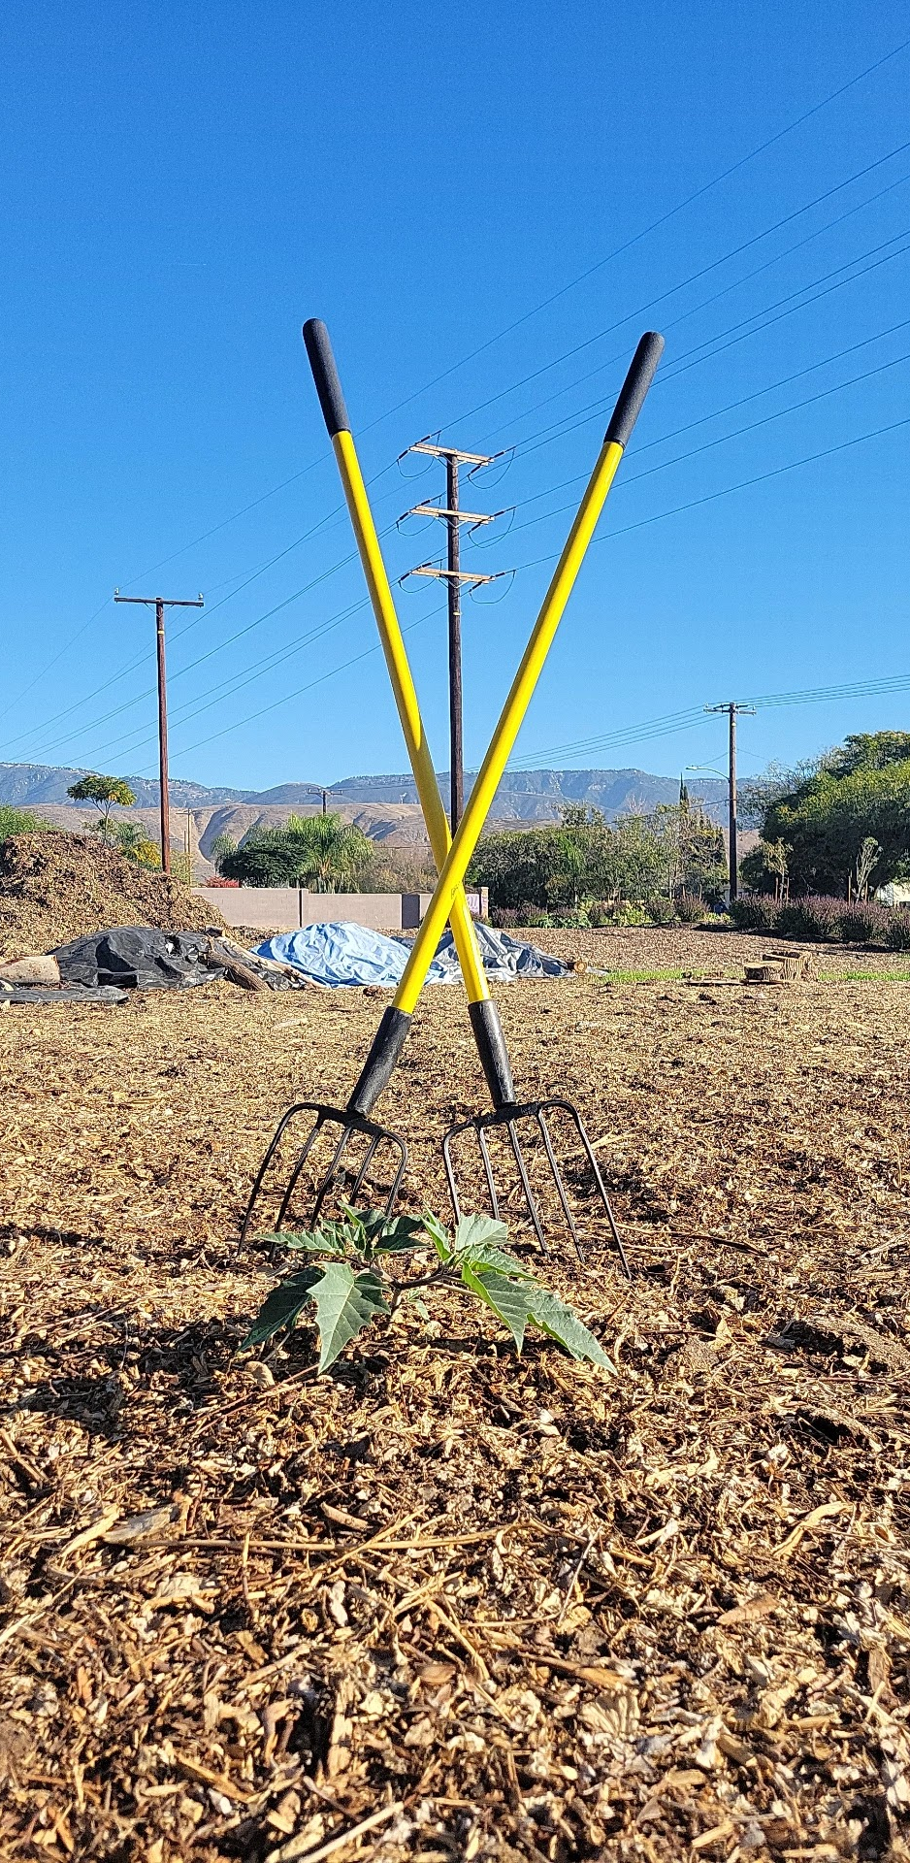
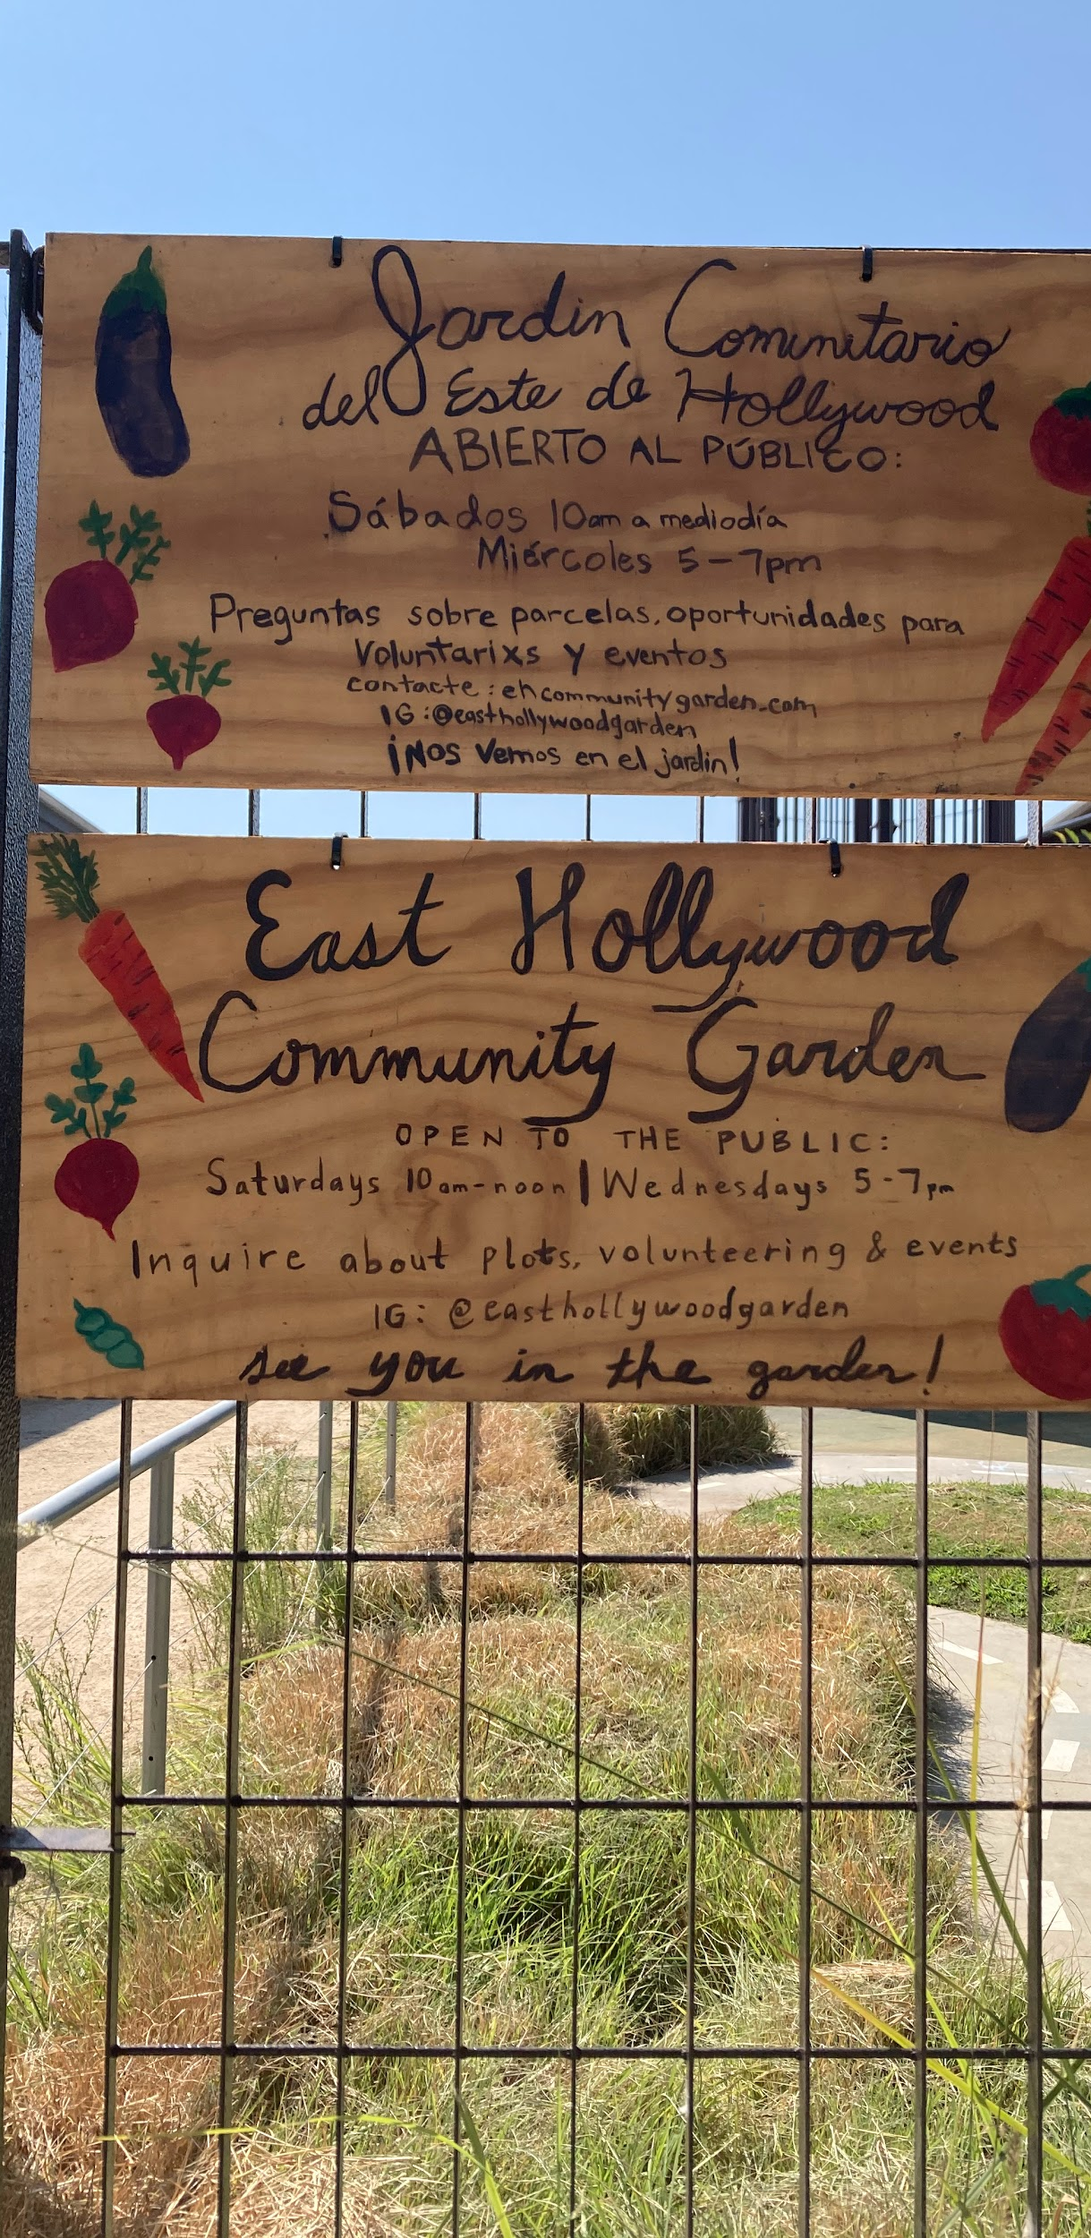
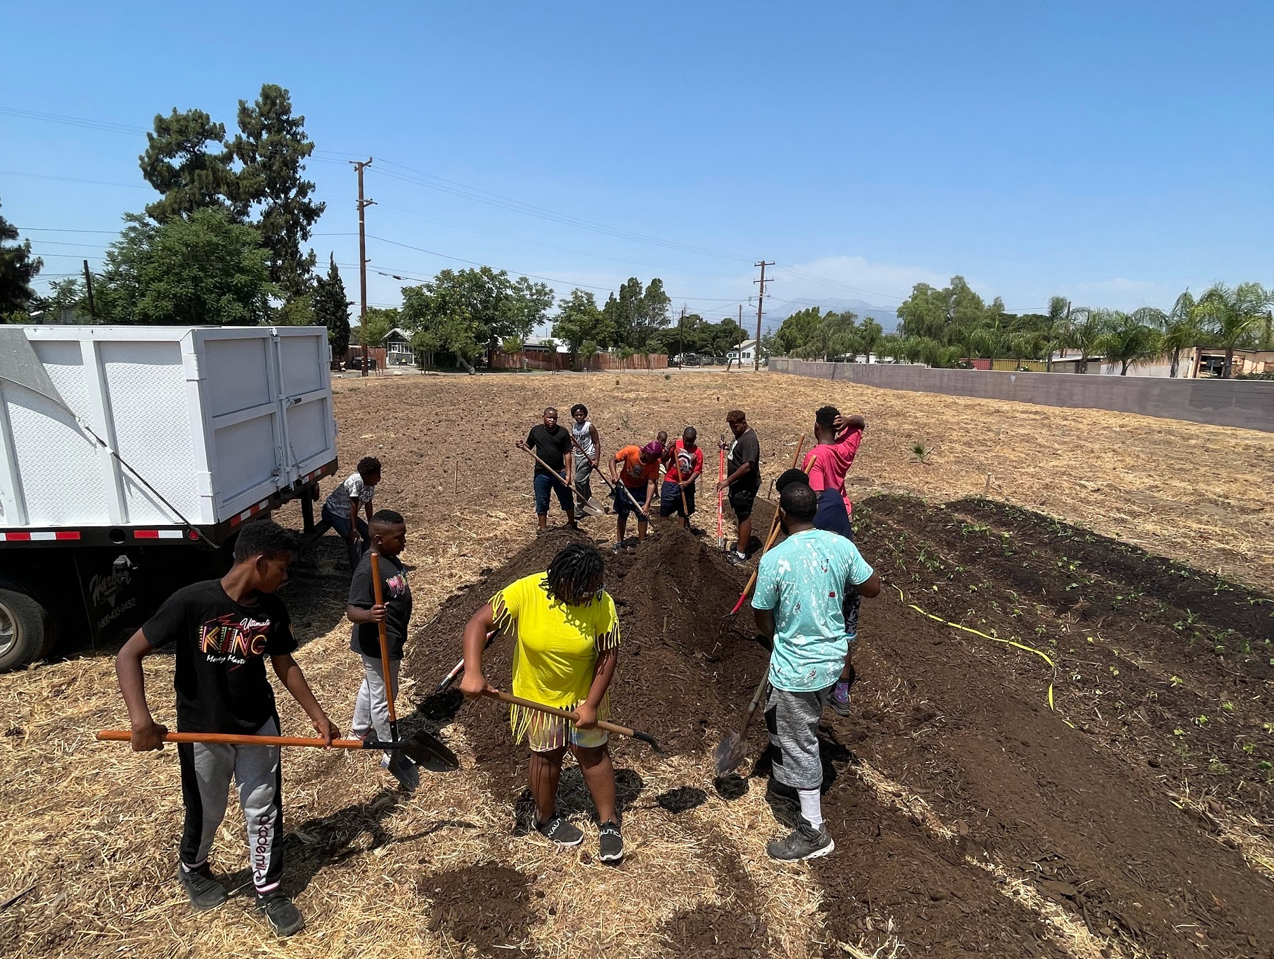
Notes:
We have completed infrastructure and green spaces development at almost 90% of our approved sites, some launching from the ground up. We’ve delivered tools, planted trees, and begun inviting the people that live in surrounding communities to come learn from this work alongside us, and encourage them to divert the organic material they generate toward local benefits.
12 sites discontinued their involvement with the program either due to loss of land access, regulatory challenges with zoning and hauling, or were not able to complete the training and planning process to launch.t
CACC therefore dealt with some reshuffling of program participants and funds in the third quarter last year to make sure we expend the full program grant, but in the end we are still working with 105 groups to launch 120 sites.

Slide 14
Data and Metrics Tracking
Key Metrics: diversion, trees, jobs, compost produced
Methodology Efficiencies
Environmental Metrics: soil and compost quality, BMPs
Community Benefits: volunteer engagement, food distributed
Notes:
For the past year, we have been tracking key performance metrics at each site.
We are currently gathering and analyzing data in for diversion, trees, jobs, and compost produced using Google forms.
Meanwhile, CACC leadership is working with software and hardware developer Epic Renewal to beta launch a free and open-source application for handheld devices that aims to make data tracking easier for site operators, community members, and volunteers.
At 10 select sites, we are also piloting remote sensing technology from WeRadiate that will measure important metrics in the decomposition process such as pile moisture, temperature, and oxygen levels.
Both these tools are intended for small-scale operators anywhere to track quality control so they can maintain best management practice standards.
Finally, we will be testing the finished compost quality at every site through both professional labs, and soon we will also be able to conduct our own tests at a community-led bioassay lab that is being created at LA Compost.
Lynn Fang has been offering pre- and post-soil quality analyses at a dozen select locations to help us measure the effectiveness of “craft compost” end uses on soil health.

Slide 15
Compost Hub
Health Assessments
Community Education
Organizational Capacity
Network Development
Food Systems
Overcoming barriers to access
Notes:
We are in the process now of conducting our final Compost Hub Health Assessments to track and measure other qualitative indicators of holistic economies and the long term sustainability of these projects
With this data we will be able to measure the full value of community composting initiatives in terms of building local self-reliance.
We’ll demonstrate that making meaningful investments in these communities, and trusting the people that live in them to steward the work, can have many amplifying effects.

Slide 16
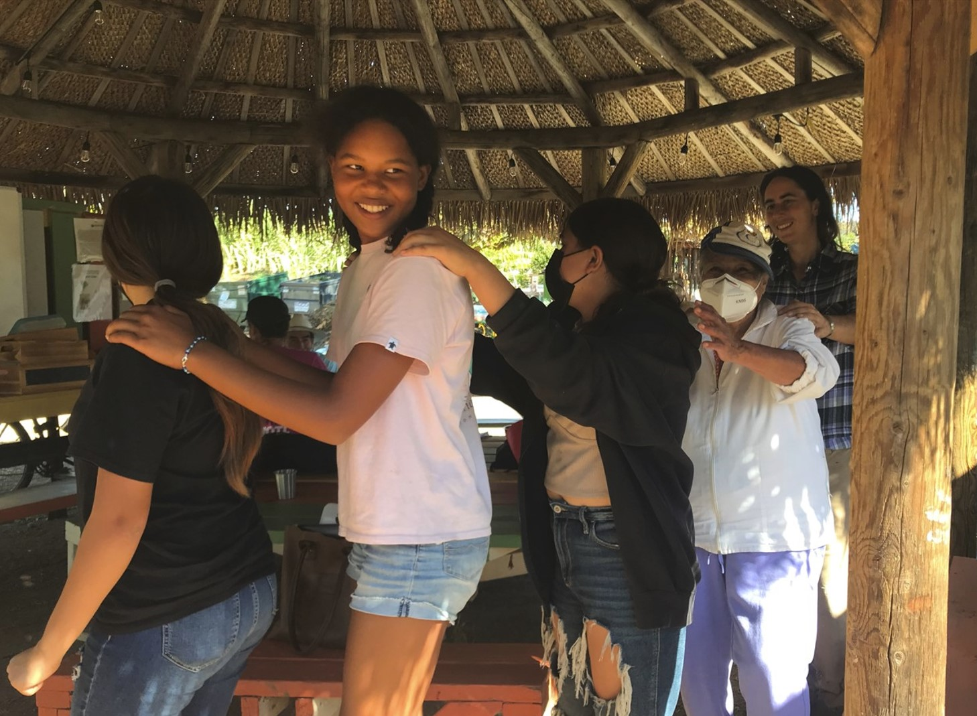
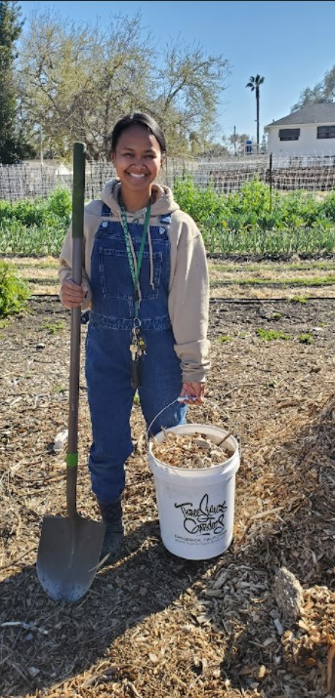
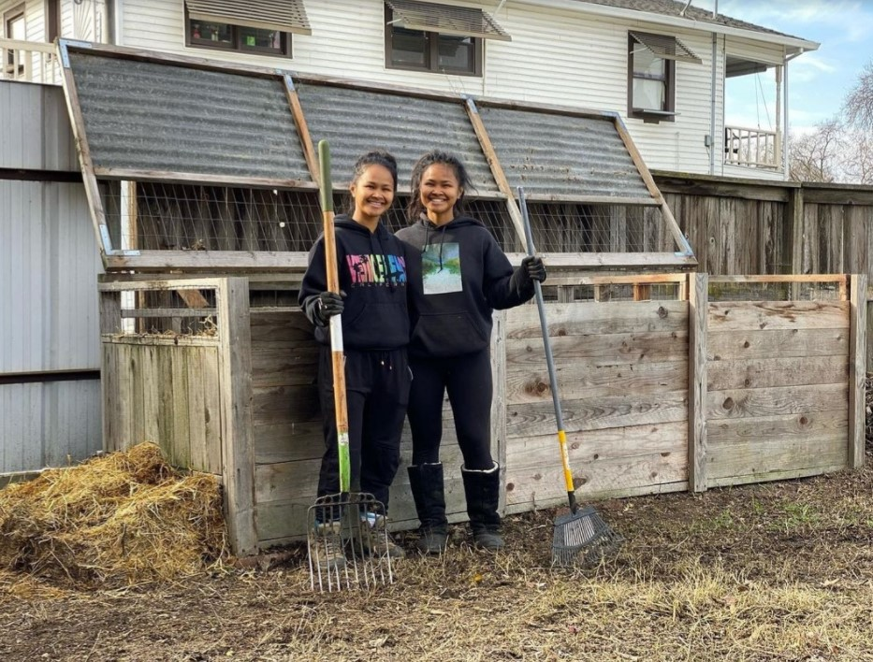
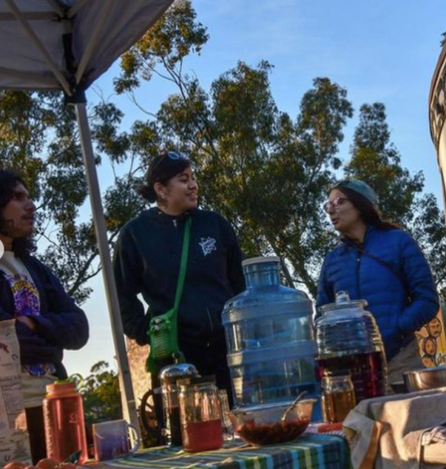
Notes:
65 part-time and place-based site operators are providing on average about 5-15 hours each week for compost operations and community engagement at CCGS sites. Last year, this translated to 12.5 full-time equivalent jobs.
The majority of these positions are held by low-income and underrepresented individuals in historically underserved communities.
In addition, groups have reported distributing fresh produce grown on-site to food insecure residents, engaging thousands of volunteer hours in hands-on project activities, and hosting hundreds of public events for people to engage on a regular basis with their compost hubs and learn about innovative methods to improve resource recovery and soil health in California.
The work is shown to be fulfilling, educational, and fun!

Slide 17
Estimated Total Program Impacts
11.2 million lbs total organics diverted
1,862 MTC02e reduced (~400 cars)
4,500 cy³ compost produced
369 trees planted
22 FTE jobs created at $23/hr
$105/ton program average for diversion
$76/ton program average for co-benefits
Notes:
- During the site proposal development phase, we calculated the estimated total emission reduction factors at each site over a period of 80 weeks based on three things:
The expected amount of food and other green material they plan to process
total trees planted
And yards of compost produced by the end of the program.
This job estimate is across the program as a whole, and includes hours spent on direct grant coordination activities as well as site operations. With just site operations, it’s 18 FTE which translated to about 80 part-time, well paid jobs.
- We also originally estimated we’d spend in total about $900K on labor and $200K on infrastructure, trees, composting testing and analysis. The cost per ton is broken down for diversion alone (in terms of both labor and infrastructure), and then the cost per ton for providing all other community benefits of the CCGS program, so that we can more accurately demonstrate the affordability of small-scale systems.
However, most programs only launched in January 2022, so they have been running for only 52-60 weeks. The second quarter saw an increase in productivity and efficiency, and site operations became consolidated under several well-skilled group members of IDI and LA Compost.

Slide 18
Annual Program Impacts in 2022
6.75 million lbs total organics diverted
1,614 MTC02e reduced (~350 cars)
2,750 cy³ compost produced
59 trees planted (+369,000 MTCO2e)
12.5 FTE jobs created at $23/hr
$104/ton program average for diversion
$96/ton program average for co-benefits
Notes:
This was our annual program impacts last year, and our AVERAGE program site cost to divert one ton of material. We’re on track to meet our program goals and we have 35% of our regional budgets left to spend.
In 2022, CACC spent $685,000 dollars supporting 105 community groups across the state of California collectively diverting 3,375 tons of organics through the 120 small compost hubs that launched or expanded as part of CCGS. Our average operations cost last year was only $200 per ton of organic material diverted, which is far below the industry average for commercial composting corporations at $373 per ton.
We estimate that CCGS project sites collectively reduced emissions by 583 MTCO2e from diversion alone, with another 1,031 MTCO2e in reductions achieved by applying the 2,750 cubic yards of compost produced last year on local gardens and farms, 369,000 MTCO2e by planting 59 trees, and an unknown amount of greenhouse gas emission reductions as a result of less vehicles miles traveled for conducting these operations.

Slide 19
What You Can Do
Educate your policy makers
Apply for Grants
Small Business Development
Notes:
Now that we know what one-and-a-half millions dollars can get you when working in a collaborative network…. It’s time to spread the news.
For us, this is what we can now present to our state legislature. “By 2025, California will need to divert approximately 26.8 million tons of organic material annually. To accommodate this, CalRecycle has estimated the state will need to spend $17.4 billion dollars establishing new organic collection, processing, and recycling infrastructure, including building about 85 new large-scale compost facilities to do so (and these are far from completion)…”
If we replicate this program with just 1% of the projected state costs for these landfill diversion investments (which is $174 million dollars), small scale recovery solutions could add up to capturing about 5% of all material generated in the state annually, and for half the cost of commercial enterprises to do the same thing. That’s something to talk to policymakers about!
And similarly at the local level, by investing just $1 million of a local county’s budget TODAY to support launching a decentralized network of 100 community-based projects in open green spaces, this is the capacity we estimate can be accomplished in under 2 years and be sustained for many more.
___
Outside of state and federal funding for compost programs, this work could also be applicable for grant programs in other related climate mitigation activities, like climate smart agriculture, healthy soils initiatives, sustainable cities, urban greening, habitat conservation, and food security.
Demand for community compost hubs is underfunded and oversubscribed in all major CA urban areas.
- I’d be interested to explore how our program concept can be leveraged to find funding from these other grant opportunities.
___
And last, one of the biggest hurdles that CACC faced was that most project groups and site operators had to be affiliated with a formal business entity in order to provide contracted services b/c of a specific new employment law in CA.
This was problematic since about 80 participants are grassroots organizations and could not afford to incorporate for the purposes of CCGS, and we could therefore not create legal jobs for them.
CACC was able to garner $50,000 in additional funding from the Open Road Alliance to formally incorporate, and then fiscally-sponsor most of them under CACC, IDI, and LA Compost umbrella organizations, and also cover the overhead costs for 6 other groups that wanted to become new small businesses of their own.
More grants that strengthen both small business and market development in the compost industry will catapult the long term financial sustainability of community-based projects.

Slide 20
cc4greenspaces@gmail.com
www.thecacc.org
Notes:
Thank you for your presence as I’ve walked through this brief overview of our story so far.
We would like to thank CalRecycle, California Climate Investments and the People Food and Land Foundation for their continued support in making these resources available.
And of course–most importantly, thank you to our CCGS regional coordinators and program participants for your patience, commitment and guidance. Without whom, none of this would be possible! And Brenda Platt and ILSR for advising us all along the way.
Please feel free to reach out to us at cc4greenspaces@gmail.com, or visit our website for more information.

