Slide 1
Marvin Hayes Executive Director Kenneth Moss Lead Youth Composter
A youth-empowered food scrap collection service, Black-owned & led business, building a diverse composting community in Baltimore

Slide 2
Compost
Learn so we don't have to burn
Starve the incinerator
Feed the soil
Feed the community!
Clean air for Baltimore.

Slide 3
According to
EPA reports:
The Wheelabrator Incinerator is the SINGLE LARGEST standing source of air pollution in Baltimore City. It stands as one of “a dirty dozen” incinerators in the country.
“
“
A waste to energy facility which converts up to 2,250 tons of municipal waste…as a local, sustainable fuel… to generate CLEAN RENEWABLE electricity.
According to Wheelabrator’s website

Slide 4
Hg
SO₂
293 lbs
82%
Pb
of LEAD, released in the form of emissions, yearly from the incinerator.
of SULFUR DIOXIDE emissions in Baltimore come from the incinerator.
LEAD can affect virtually EVERY organ system.
Relatively low levels can affect nervous system development, especially in children & babies.
SULFUR DIOXIDE reduces lung function and causes incidents of respiratory symptoms & diseases.

Slide 5
Hg
SO₂
52 lbs
89%
Pb
of MERCURY, released in the form of emissions, yearly from the incinerator.
of MERCURY emissions in Baltimore come from the incinerator.
MERCURY can affect the nervous, immune, kidney, & digestive systems in addition to your lungs. Effects are irreversible.
MERCURY affects children and babies at rates higher than adults. Primarily affects neurological development.

Slide 6
Waste Processing Hotspots
Depressed Land Values + Increased Health Concerns
Environmental Justice Communities Bear Burden
Once a facility is located in an area, it can create a precedent for concentrating other waste related facilities nearby.
Depressed land values allow other waste related industries to move in due to lower land values. Residents suffer severe health impacts including, but not limited to, increased rates of asthma.
Curtis Bay, a community in Baltimore, houses a medical incinerator, coal terminal, & chemical processing plant in addition to the incinerator. Residents report higher rates of asthma & respiratory illnesses when compared with other zip codes in Baltimore City.

Slide 7
the wind
doesn't segregate
or discriminate…
ENVIRONMENTAL JUSTICE
COMMUNITIES
Within a 3-mile census tract, Wheelabrator Baltimore has a population that is 66 % minority & resides at 50 % below the federal poverty rate

Slide 8
WHAT’S COMPOSTING GOT TO DO WITH INCINERATION?

Slide 9
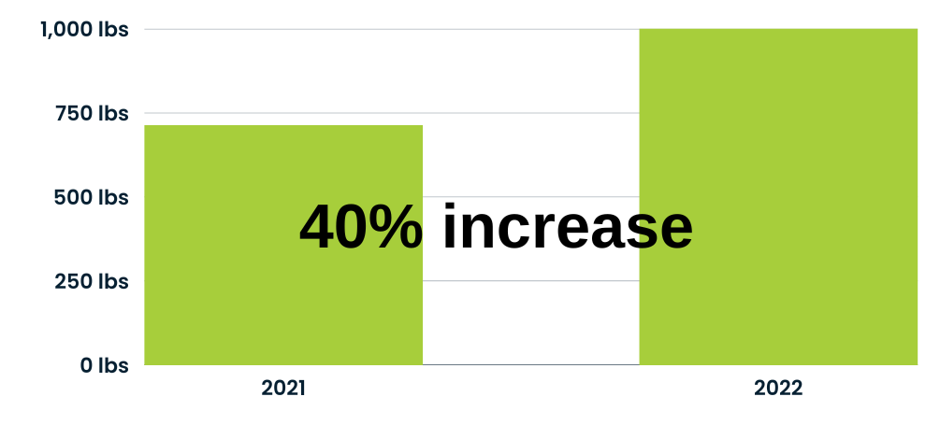
THOUSANDS OF POUNDS OF MUNICIPAL WASTE DIVERTED
In 2022, an average of over 1,000 pounds per week collected an increase of 40% over 2021.
49 pick-ups

Slide 10
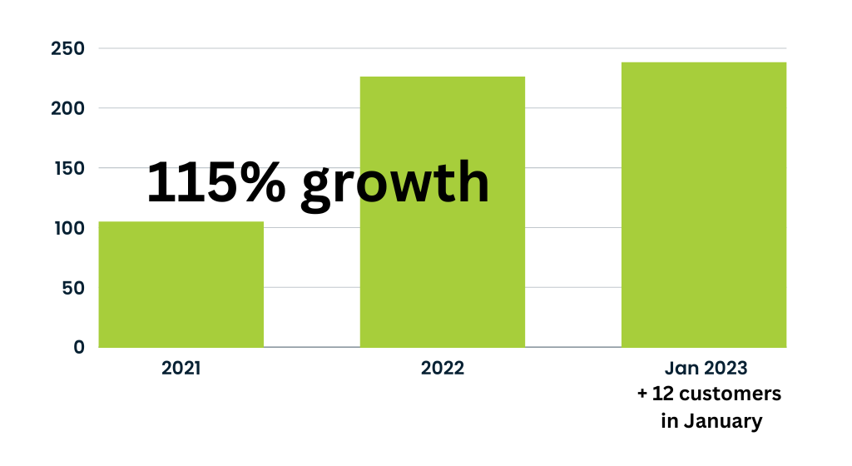
SPREADING THE LOVE OF COMPOSTING WITH A PURPOSE
At the end of 2022, the Collective had a 115% in increase customer #s

Slide 11
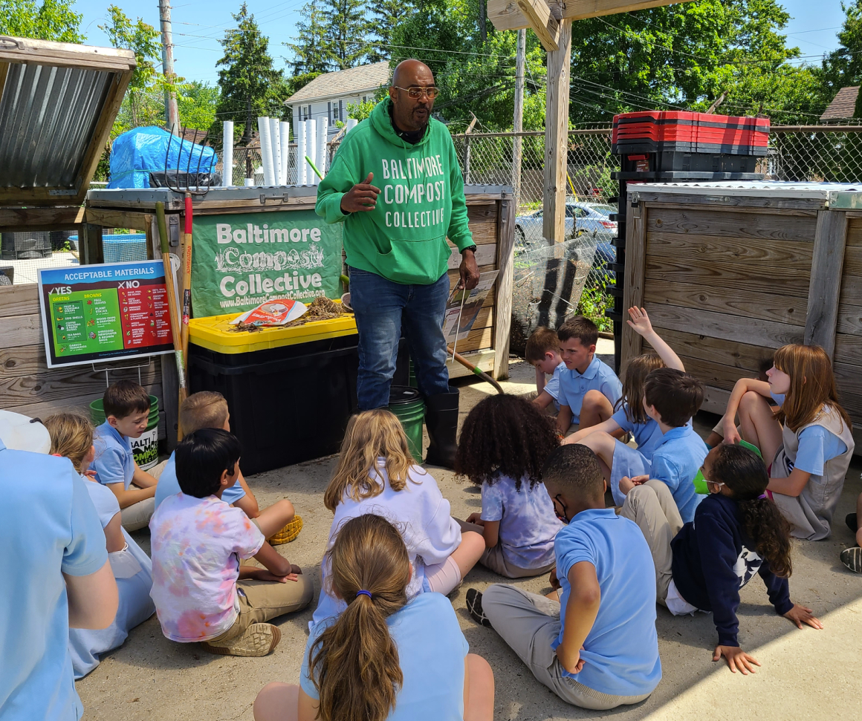
SPREADING COMPOST FEVER
THRU THE VARIANT OF EDUCATION
PRESENTED AT OVER 40 EVENTS
reaching over 1500 people in person
over 3,000+ viewings online
including over 350 youth & school
groups

Slide 12
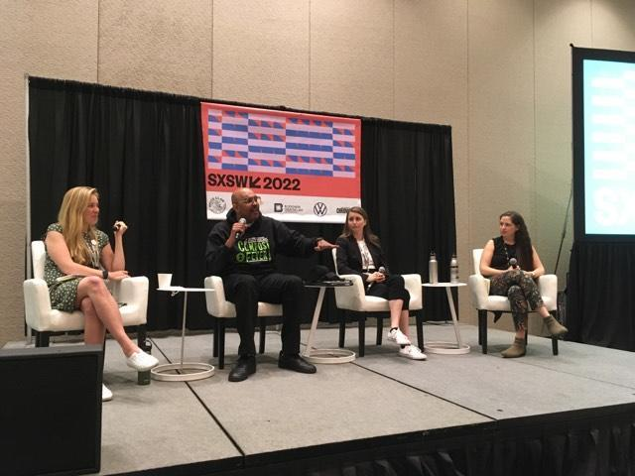
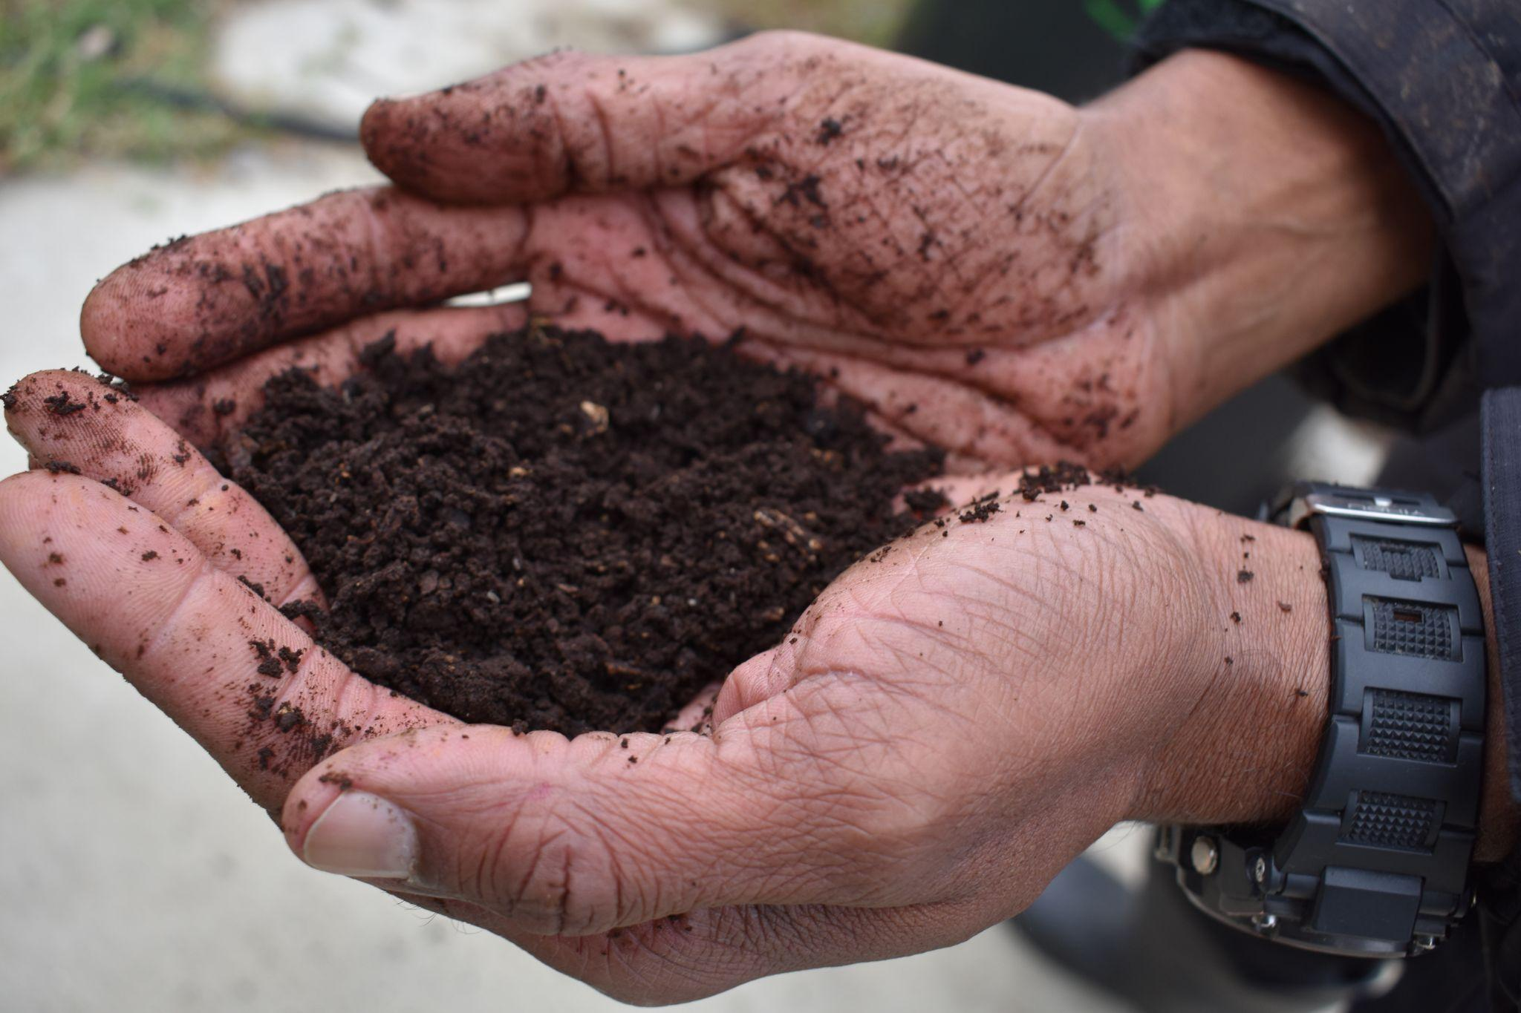
SPREADING COMPOST FEVER THRU THE VARIANT OF EDUCATION
IN BALTIMORE & BEYOND …
Panelist with NRDC @ South by Southwest Austin, TX
Speaker @ ReFed Conference
Minneapolis, MN
Compost Facilitator & Educator
@ first all-Black-led composting training
(Black Excellence)
Detroit, MI

Slide 13
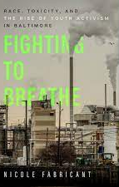
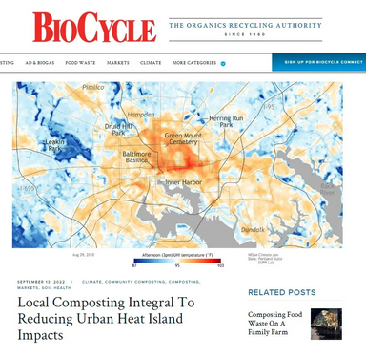
FEATURED
IN:
Fighting to Breathe: Race, Toxicity, and the Rise of Youth Activism in Baltimore
by Nicole Fabricant; professor Towson University
The Black Butterfly: The Harmful Politics of Race and Space in America
By Lawrence T. Brown; professor
Podcast: My Block Counts Environmental Justice Podcast powered CEEJH WYPR
News Articles From:
Biocycle, The Guardian & The Baltimore Sun

Slide 14
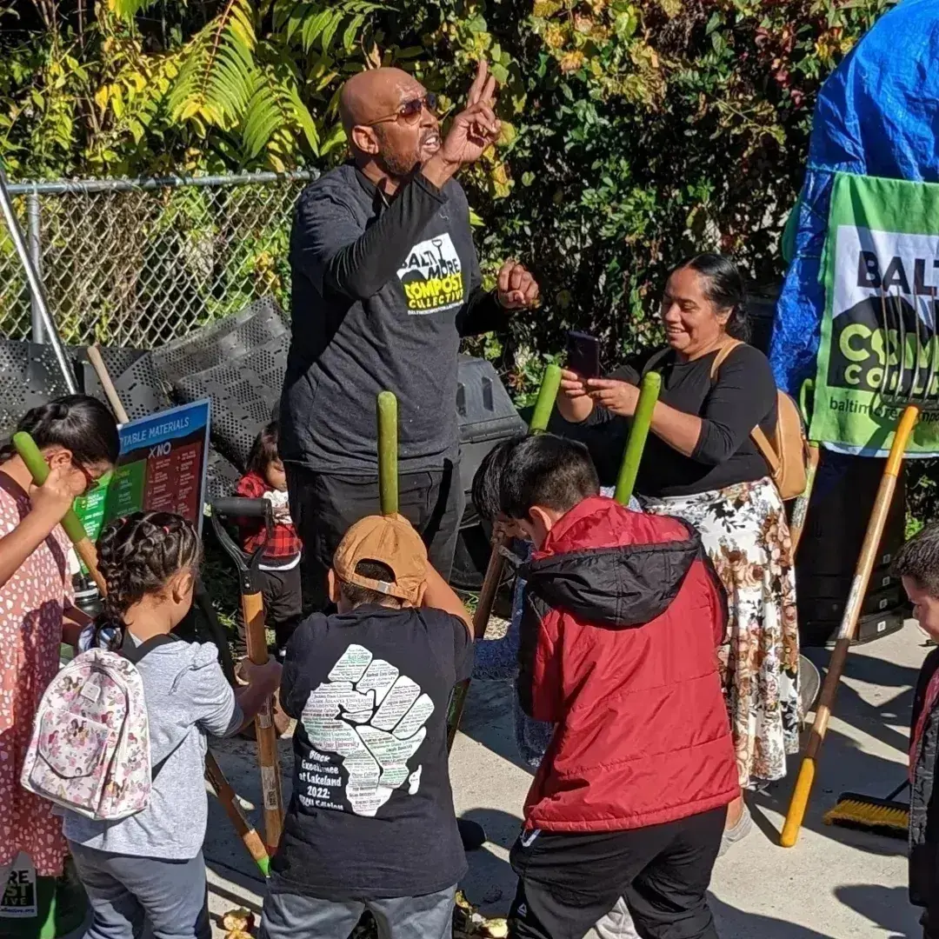
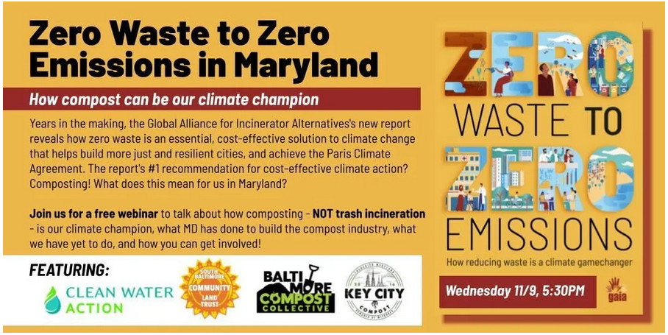
MOVING BALTIMORE
FORWARD - ReCYCLEMORE
We’re not waiting for the city to bring us to the table, we are continuing to build our own inclusive composting table for Baltimore.

Slide 15
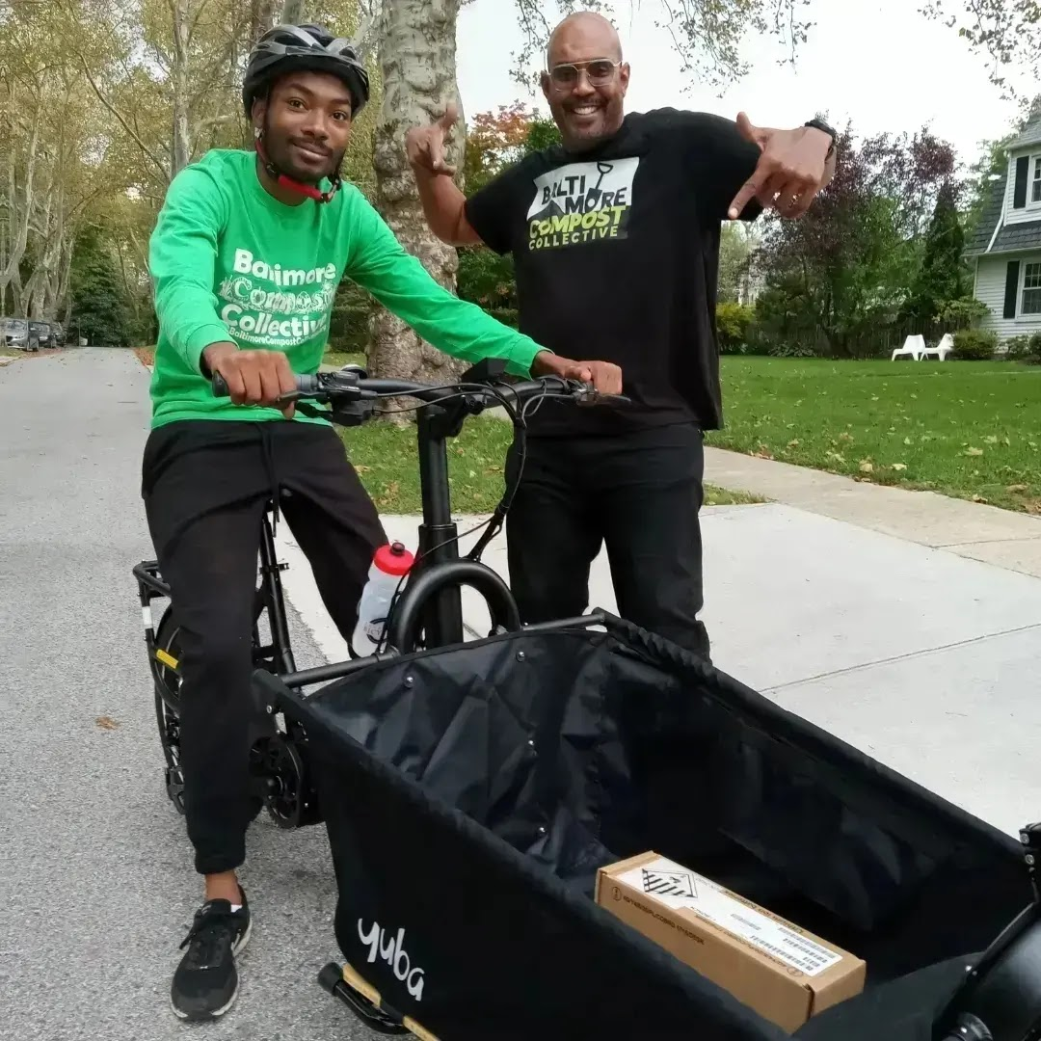
IT’S ELECTRIC…
BUILDING THE FIRST ALL ELECTRIC FLEET
In partnership with Yuba Bikes, the Collective purchased 2 electric bikes with front loading capabilities
Bike-powered food scrap collection service will be piloted in February

Slide 16
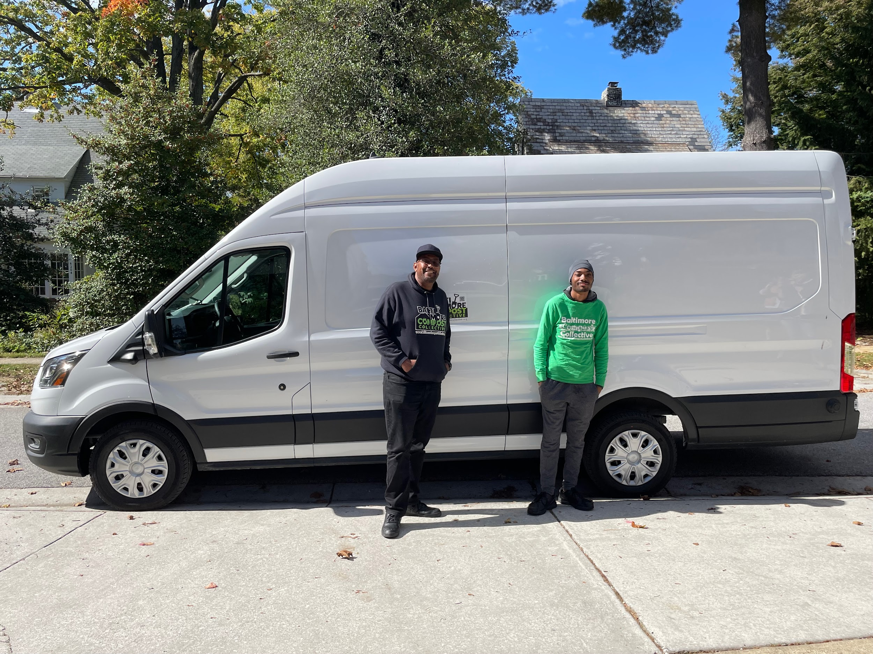
IT’S ELECTRIC… BUILDING THE FIRST ALL ELECTRIC FLEET
New electric van transforms the fleet & operations, providing increased capacity
& a fuel savings of over 60%
NO EMISSIONS

Slide 17
MERCHANDISE
T-shirts
S/M/L/XL
$25
All proceeds benefit
the Collective

Slide 18
Kenny Video

Slide 19
CONTACT INFO
Marvin Hayes
baltimorecompostcollective@gmail.com

Slide 20
HELP US STARVE THE INCINERATOR
DONATE NOW

